Slide 1
Spatial Memory and Multisensory Perception in Children and Adults
Marko Nardini, James Negen
Psychology

Slide 2
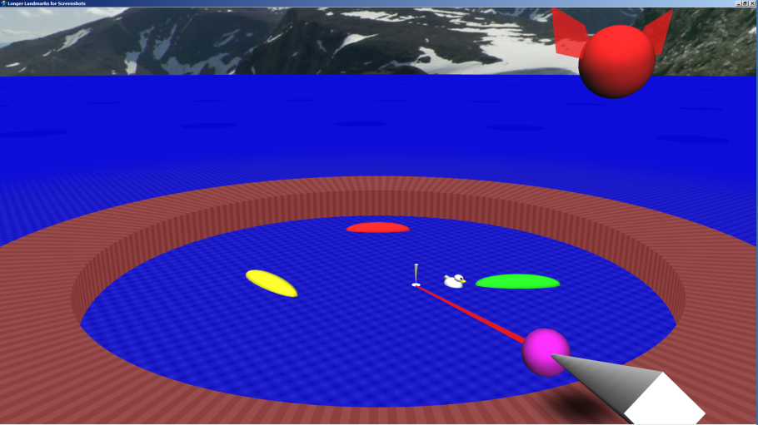
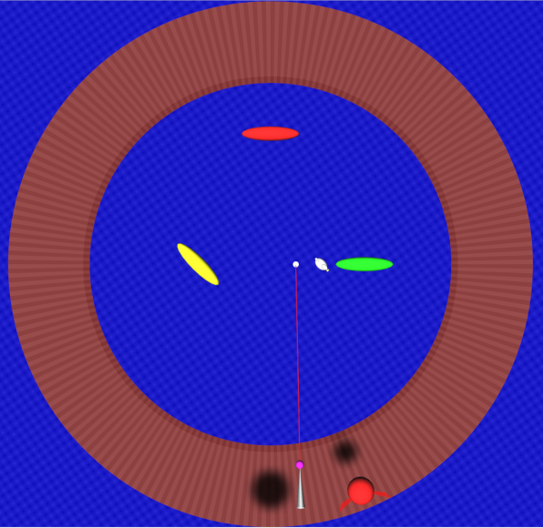
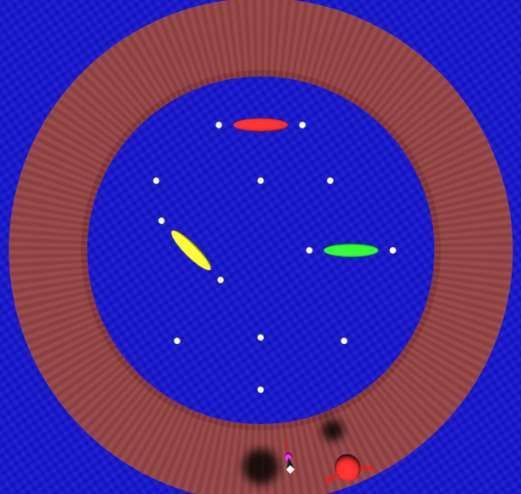

Slide 3
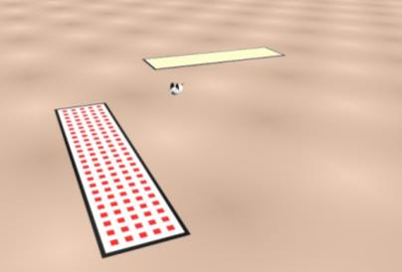
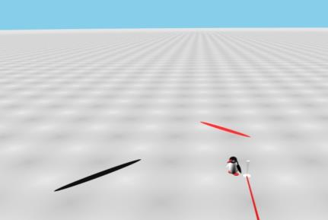
Example Environments for Children

Slide 4
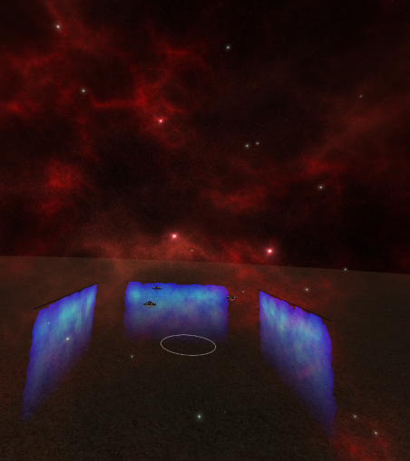
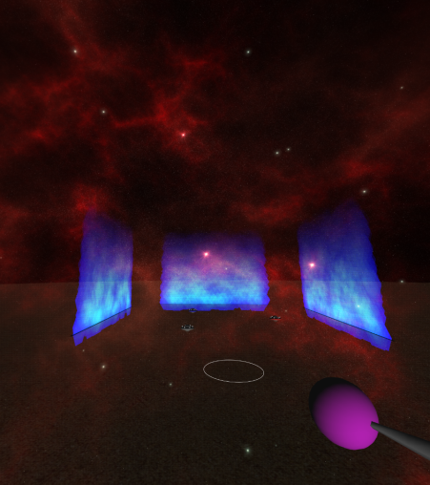
Additional Challenges for Adults

Slide 5
Uncertainty reduction via cue combination
Adults
AxB
A
B
Likelihood
VISION
AUDITION
Location
COMBINED
Children to ~10 years
A
B
Ernst & Banks, Nature 2002; Alais & Burr Curr Biol 2004
Nardini et al Curr Biol 2008; Gori et al Curr Biol 2008; Dekker et al Curr Biol 2015
Notes:
As we heard from the last speaker, in many situations human ADULTS reduce uncertainty by combining sensory estimates.
Intriguingly, though, many studies show children unable to do this until after around 10 years of age

Slide 6
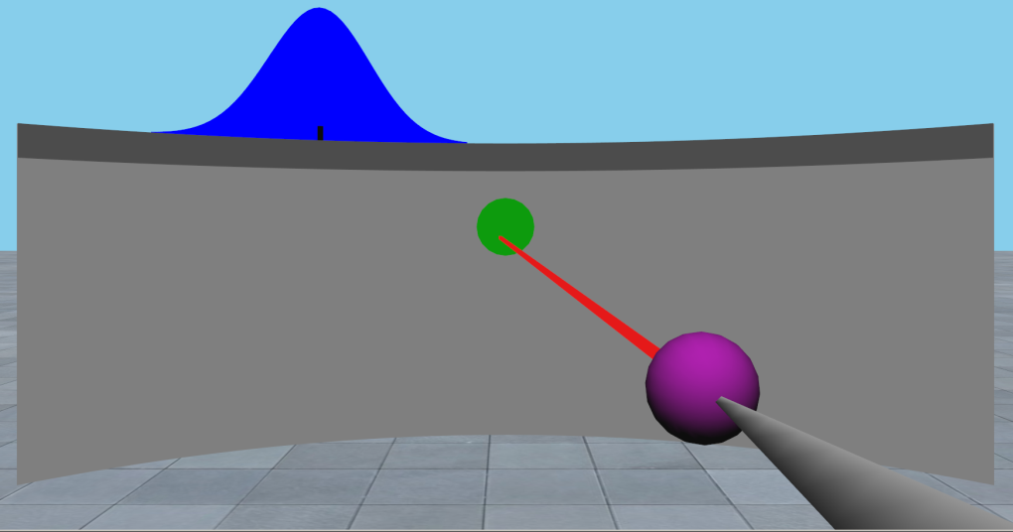
Audio-Visual Localization Task for Children
8.0-9.9 Years
~240 Trials
87 kids
Reliability of visual stimulus is intuitively communicated by its width, which varies from 50% to 200% of audio reliability
Audio cue is 300ms of modulated white noise through dummy-head HRTF from CIPIC

Slide 7
Model Comparison Analysis
Audio
Vis
Optimal
Audio Only
Mis- Weighted
Visual Only
Single Weight
Switching

Slide 8
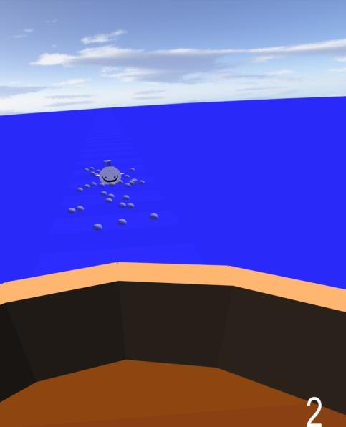
Echo Learning Task for Adults
Judging distance outwards
Using an echo (“sonar pulse”)
Also given visual cue to learn
Sometimes presented both at once

Slide 9
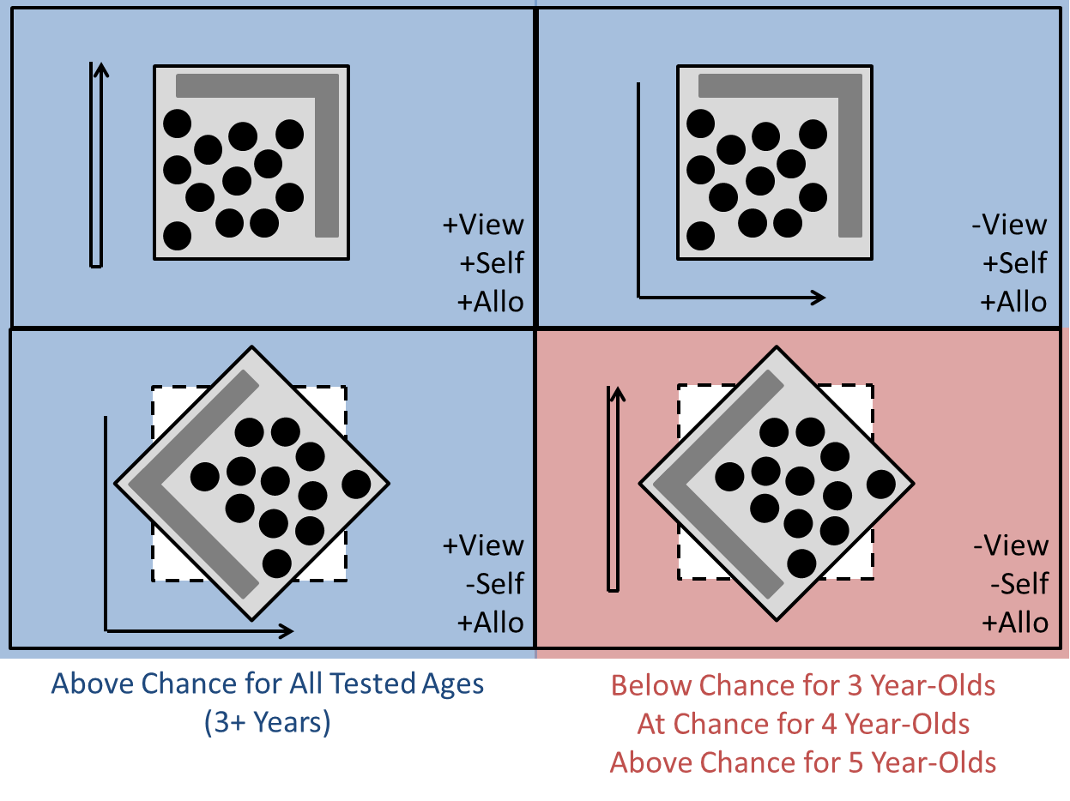

Slide 10
Cue Mixing Fit Over 3-6 Years

Slide 11
Summary
Spatial Memory
Cue Combination
Remembering where things are
Current standard: predicting average error
What we want: predicting distributions of responses to better understand how they are produced
Future: Understanding what constraints make imperfect cognitive methods sensible
Using two noisy sources of information together to do better than with either one
Current standard: predicting reduction in average error with second cue
What we want: predicting distributions of responses to better understand how they are produced
Future: Understanding what constraints make imperfect cognitive methods sensible

Slide 12
Contact Info
Marko Nardini
Marko.nardini@durham.ac.uk
Psychology
James Negen
James.negen@durham.ac.uk
Psychology

