Slide 1


Data Assimilation and Modelling the Carbon Cycle
Philip Aston, Anna Chuter, Sylvain Delahaies,
Anne Skeldon, Nancy Nichols (Reading),
Ian Roulstone
University of Surrey and NCEO

Slide 2

Outline
The Data Assimilation-Linked ECosystem model (DALEC)
A dynamical systems approach
Sensitivity analysis
Data assimilation
Model and data resolution matrices
Constraining DALEC v2 using multiple data streams and ecological constraints: analysis and application – Delahaies, Nichols and R, Geophys. Model Dev. 2017

Slide 3
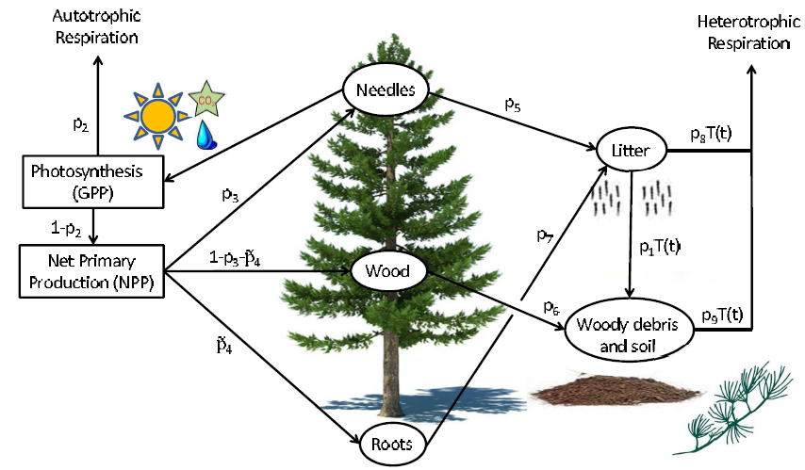
Carbon Cycle

Slide 4
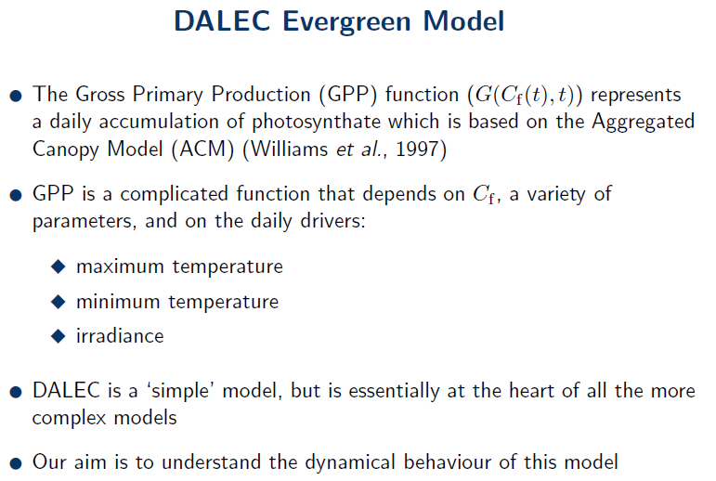
DALEC EV

Slide 5
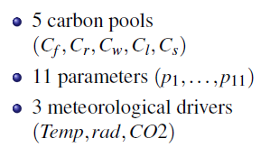
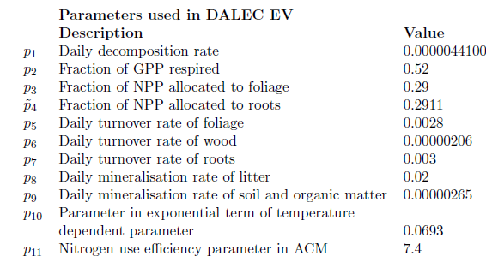
Pools and Parameters

Slide 6
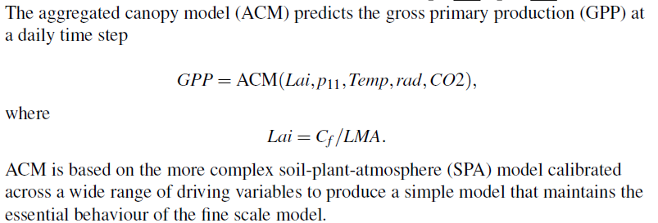
Canopy Model and Leaf Area Index

Slide 7
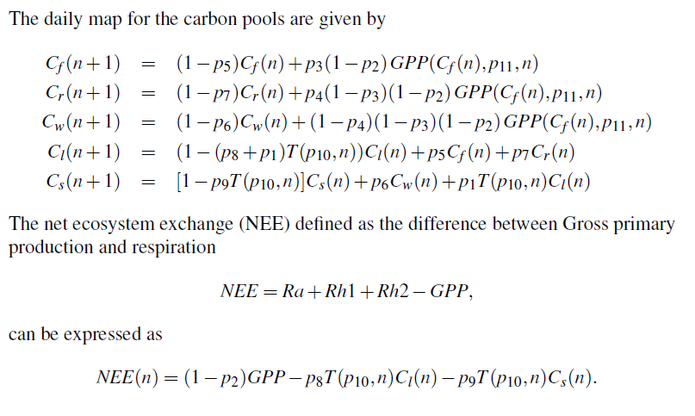
Towards Differential Equations

Slide 8
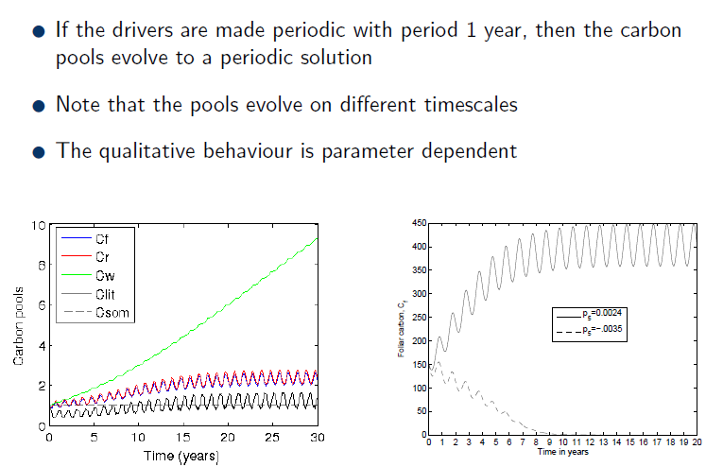
DALEC Dynamics

Slide 9
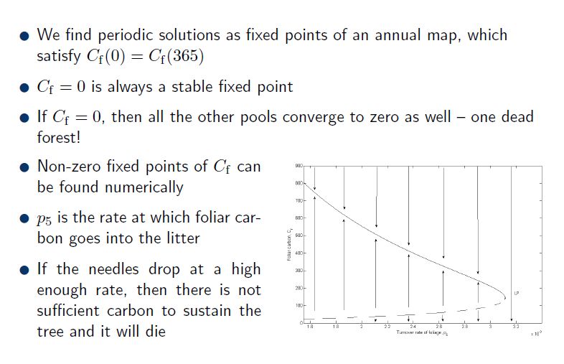
Periodic Solutions

Slide 10
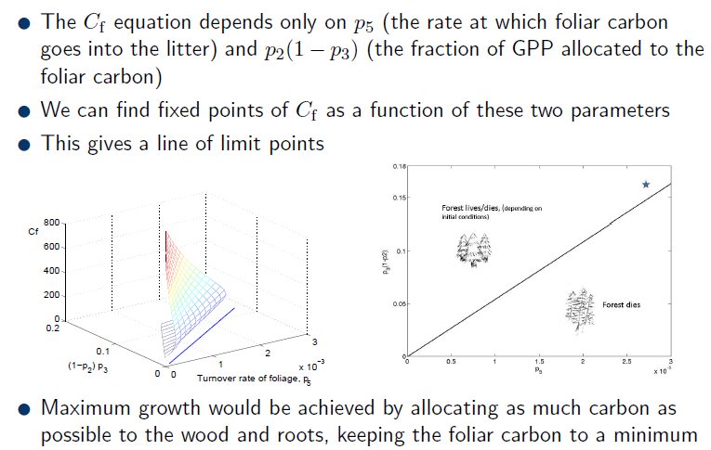
Limit Points

Slide 11
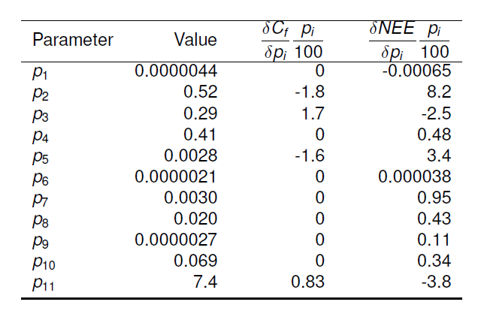
Sensitivity

Slide 12
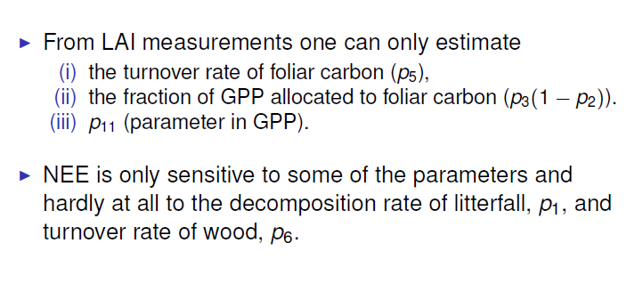

Sensitivity

Slide 13
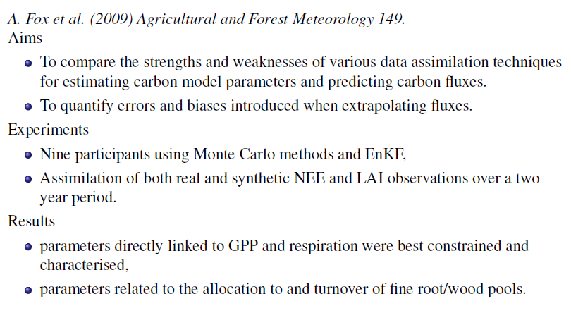
REgional Flux Estimation EXperiment
(REFLEX)

Slide 14
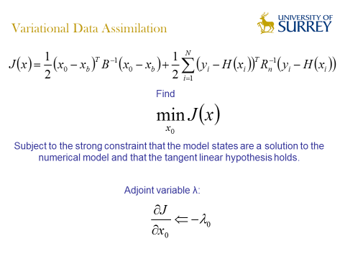
4D VAR

Slide 15
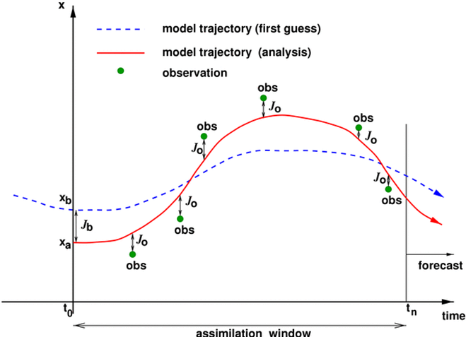
4D VAR

Slide 16
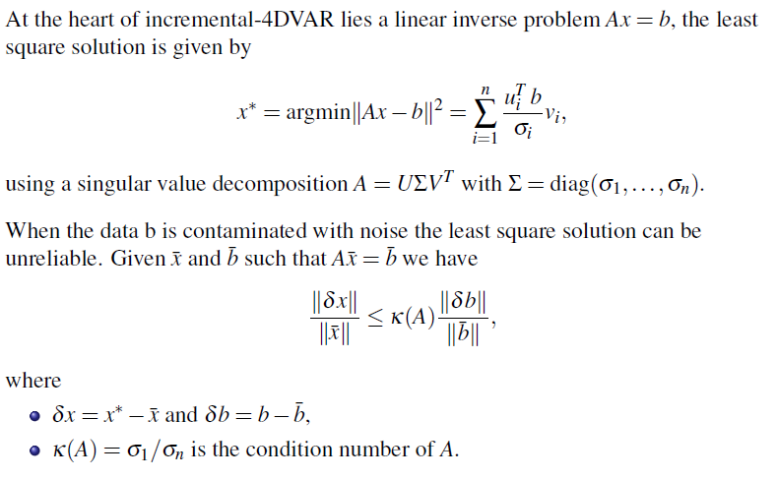
Inverse Problem and
Data Assimilation

Slide 17
Well-posedness
A generic inverse problem consists in finding a n-dimensional state vector x such that
h(x) = y
for a given N-dimensional observation vector y, including
random noise, and a given model h. The problem is well
posed in the sense of Hadamard (1923) if the three following conditions hold:
a solution exists,
the solution is unique, and
3) the solution depends continuously on the input data.

Slide 18
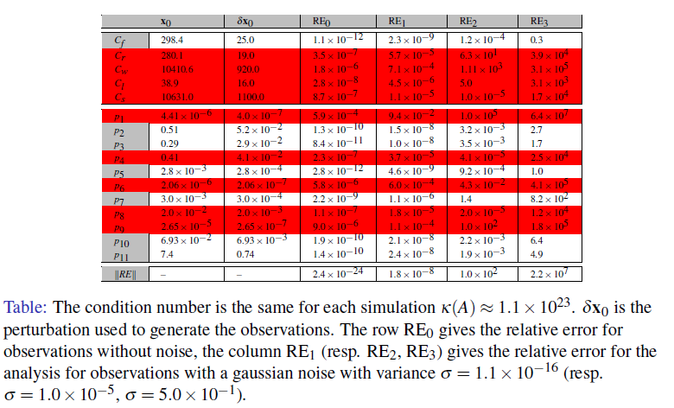
An ill-posed problem

Slide 19
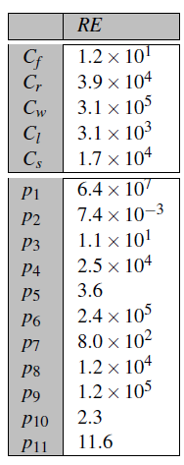
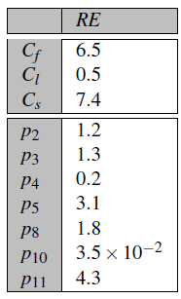
Model Reduction?

Slide 20
Linear Analysis
Considerable theoretical insights into the nature of the inverse problem, and the ill-posedness, can be obtained by studying a linearisation of the operator h. A first approximation to the inverse problem consists in finding a perturbation z which best satisfies the linear equation
Hz = d
where H is the tangent linear operator for h and d is a perturbation of the observations.

Slide 21
Finding a solution z amounts to constructing a generalized inverse H^{g} such that formally
Z = H^{g} d
Assuming a true state z* exists, possibly unknown, then we can define an operator N called the model resolution matrix which relates the solution z to the true state
z =H^{g} Hz* =Nz*

Slide 22
This matrix N gives a practical tool to analyse the resolution power of an inverse method, that is its ability to retrieve the true state, including or not any regularization method
The closer N is to the identity the better the resolution.
The trace of the matrix defines a natural notion of information content (IC).
Similarly a data resolution matrix can be defined to study how well data can be reconstructed and its diagonal elements naturally define a notion of data importance.

Slide 23
Model Resolution: LAI

Slide 24
Reduced Model

Slide 25
EDCs

Slide 26
Future Work
Sensitivity analysis of TRIFFID/JULES (Met O model)
Sensitivity analysis of visible radiance, near infrared radiance and vegetation index, to the model parameters of the two-stream Sellers approximation of radiative transfer (with NPL)

