Slide 1
Twisted Kähler-Einstein Currents and
Relative Pluricanonical Systems
Hajime TSUJI
Sophia Univesity
Durhan
July 2 , 2012

Slide 2
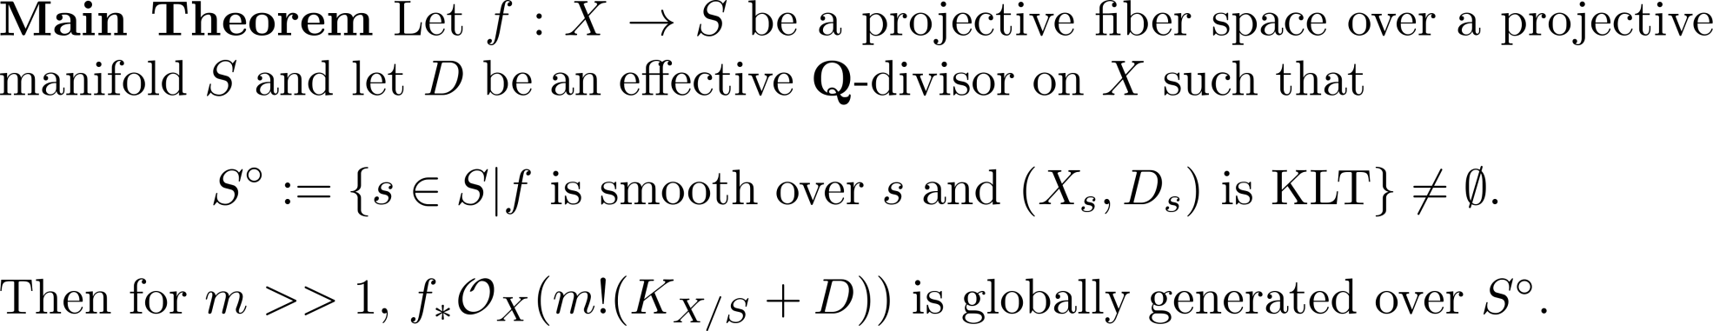
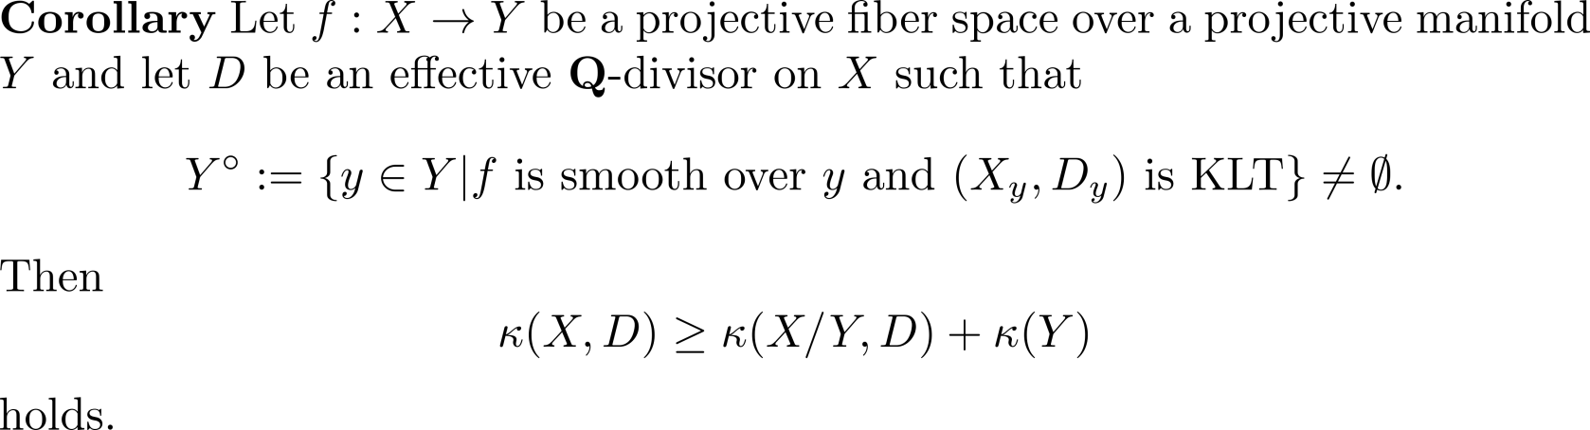
Main Result

Slide 3
Scheme of the proof
Construction of Twisted Kähler-Einstein metrics
Plurisubhamonic Variation of The metrics
Parameter dependence of the metrics
Monge-Ampère foliation
Global generation

Slide 4
Canonical metrics
Construct a canonical singular hermitian metrics on the canonical bundle of the varieties.
Requirement : The metrics varies in a plurisubharmonic way,i.e. the metrics has semipositive curvature on projective families(hopefully also for Kähler families).
The metrics defines the Monge-Ampère foliation on the family.

Slide 5




Kähler-Einstein metrics
Kähler-Einstein
Theorem (Aubin-Yau)

Slide 6
Canonical ring
We want to construct a (singular) Kähler metric which reflects the
canonical ring.

Slide 7

Iitaka fibration
Iitaka fibration is the most naïve geometric realization of the positivity of the canonical ring.

Slide 8



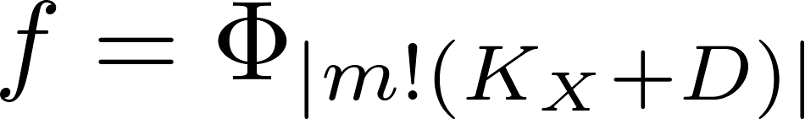




Iiaka fibration 2

Slide 9
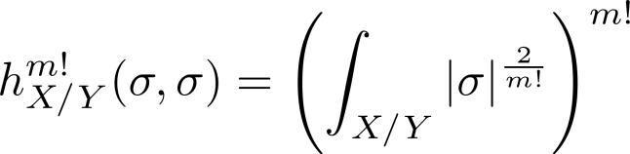
Hodge Q-line bundle

Slide 10

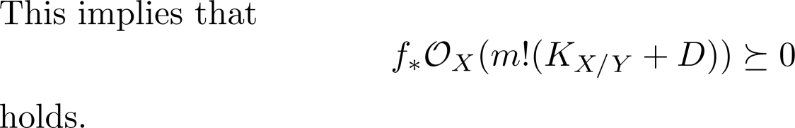
Hodge metric
By the variation of Hodge structure we have :

Slide 11

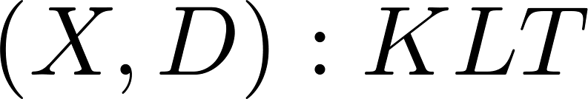


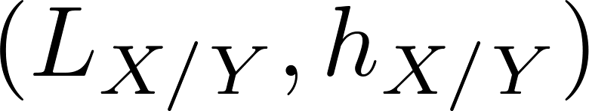
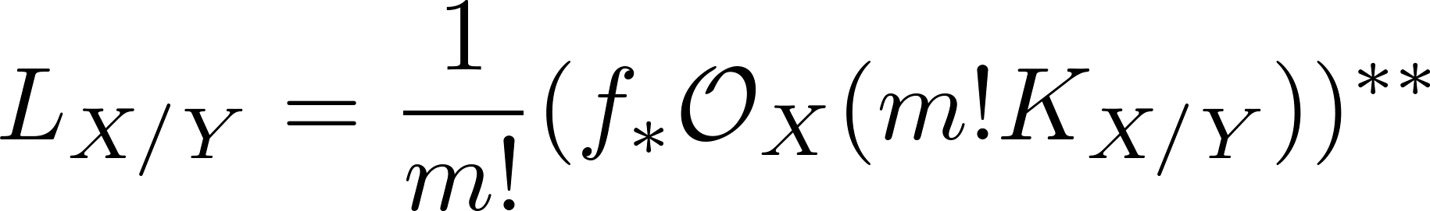
Fig.1

Slide 12

Twisted Kähler-Einstein currents

Slide 13






Existence of Twisted Kähler-Einstein currents
Theorem
Let
be a KLT pair with
And let
be the Iitaka fibration of
. And let
be the Hodge line bundle with the Hodge metric.
Then there exists a unique twisted Kähler-Einstein current
on

Slide 14

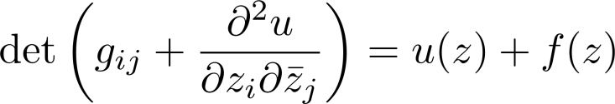
Monge Ampère equation
Complex Monge-Ampère equation

Slide 15
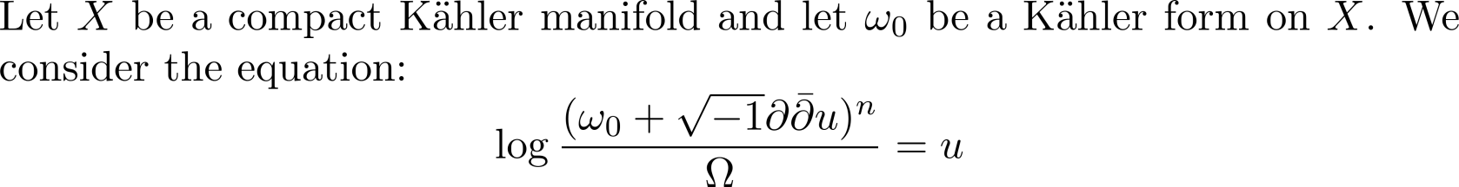
Monge-Ampère equations on compact Kähler manifolds

Slide 16



Relative Iitaka fibrations

Slide 17
Relative Twisted Kähler-Einstein currents

Slide 18
Relative Twisted Kähler-Einstein currents 2

Slide 19

Variation of Twisted Kähler-Einstein currents
Theorem

Slide 20




Dynamical system of Bergman kernels
Approximate in terms of Bergman kernels.

Slide 21
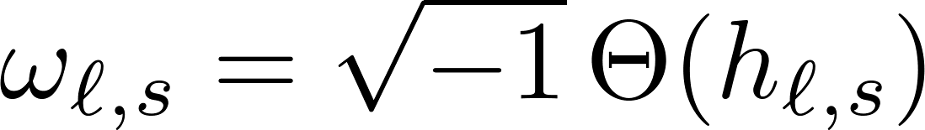
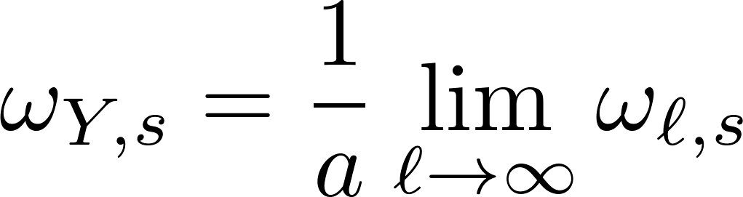
Monge-Ampère equations and Bergman kernels

Slide 22



Berndtsson’s theorem(with Păun)

Slide 23
Use of the Plurisubharmonicity of Bergman kernels

Slide 24
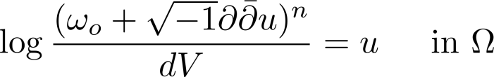

Dirichlet problem for complex Monge-Ampère equations
We consider the Dirichlet problem:

Slide 25
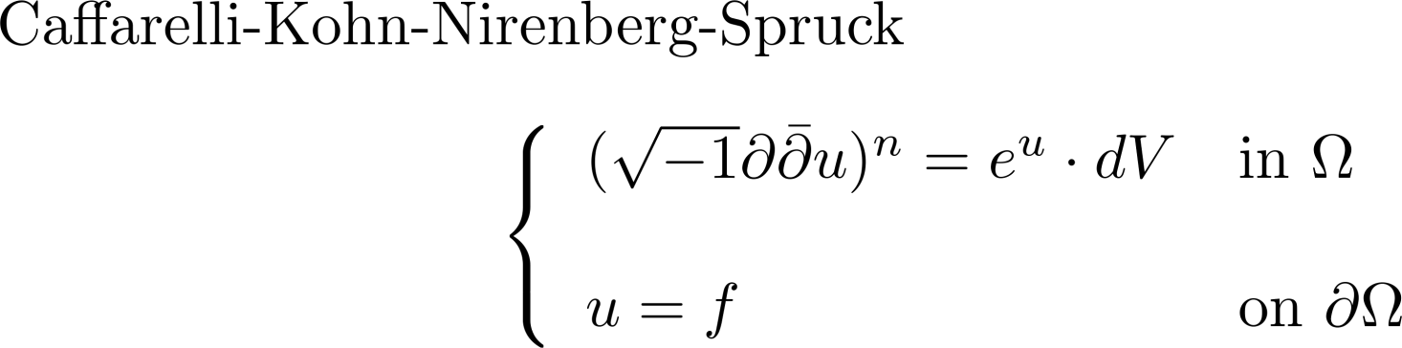
Boudary regularity

Slide 26
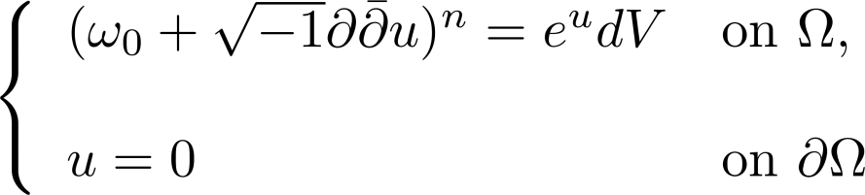

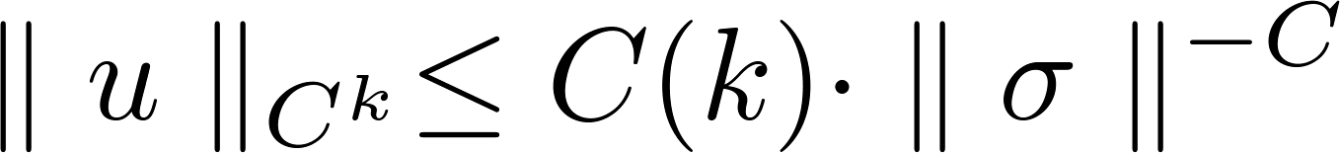
Interior regularity

Slide 27
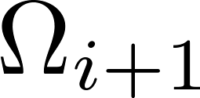


Dirichlet construction of twisted Kähler-Einstein currents I

Slide 28
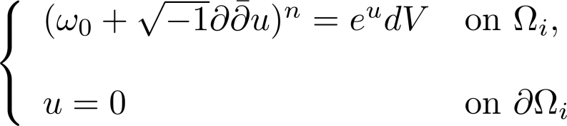
Dirichlet problem for complex Monge-Ampere equations II

Slide 29
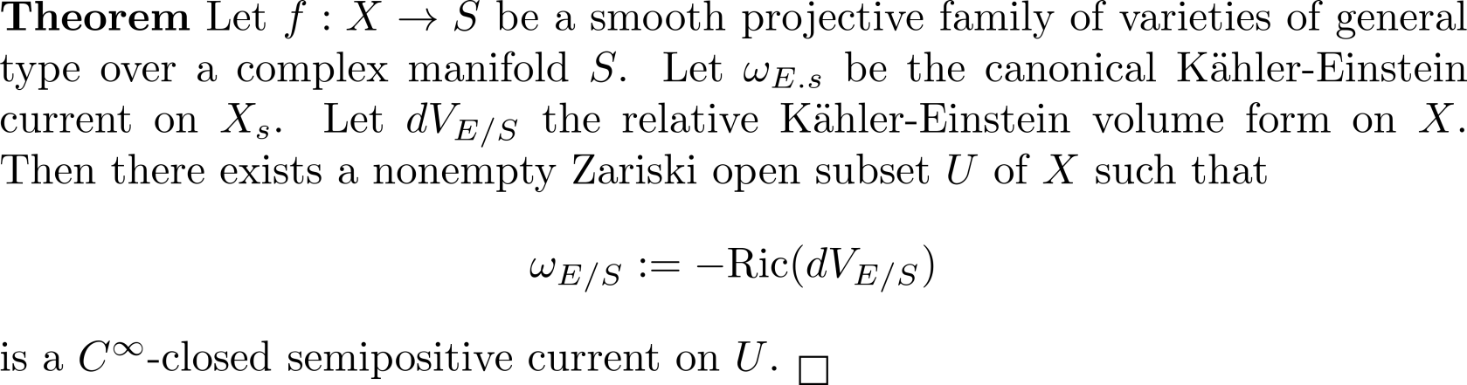
Smoothness

Slide 30
Proof of the smoothness
(1) Construct the twisted Kähler-Eisntein current as the limit of Dirichlet problems of complex Monge-Ampère equations.
(2) Consider the family of exhaustion via strongly pseudoconvex domains and apply the implicit function theorem to the solution of complex Monge-Ampère equations.
(3) Apply the weighted uniform estimates to the solution and taking the limit for the horizontal derivatives.

Slide 31
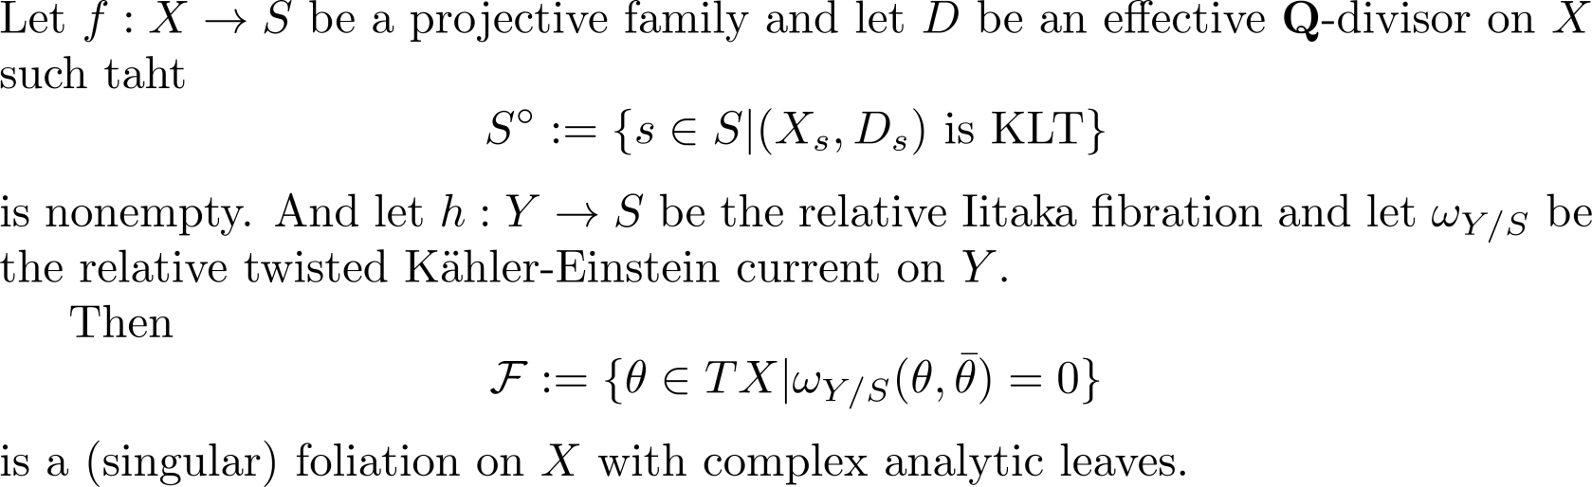
Monge-Ampère foliations

Slide 32
Descent of leaves

Slide 33
Use of the weak semistability

Slide 34



Flatness of the relative canonical systems along leaves

Slide 35


Isometries

Slide 36
Closedness of the leaves

Slide 37
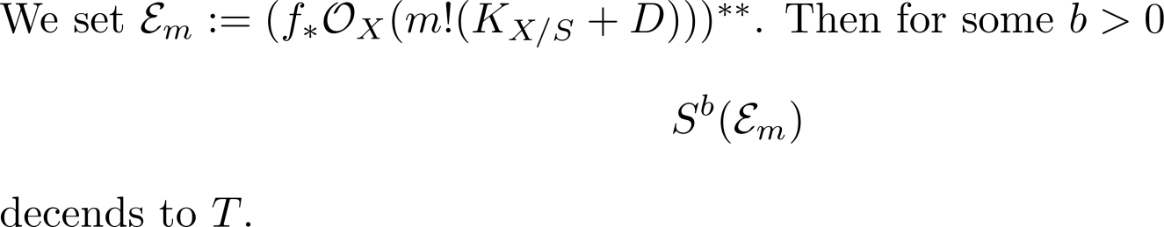
Decent of the positivity

Slide 38
Positivity of the determinant

