Slide 1
Practical challenges faced when using modern approaches to numerical PDEs to simulate petroleum reservoirs
Halvor Møll Nilsen, SINTEF ICT

Slide 2
Our groups work
Which subject do we come from
  Hyperbolic conservation laws
  (Geometrical Integration, computational geometry, Physics)
History of the research in reservoirs,
  From: Complicated methods for simple problems like (incompressible 2phase flow)
    Discretization: (Eliptic; mimetic, mpfa, Hyperbolic: fronttracking, reordering, operator splitting)
    Multiscale (Mixed finite element,m Finite Volume .)
    Streamlines (Fronttracking)
  To: Simple Methods for complicated problems
    fast prototyping, model reduction, optimization, EOR
Software:
  Matlab Reservoir Simulation Toolbox (MRST)
    Collection of our research
    Research tool
    Fast prototyping
  Open Porous Media (OPM) C++
    Platform for implementing methods on Industry standard models
People (Current):
  Knut Andreas Lie
  Stein Krogstad
  Atgeirr Rasmussen
  Xavier Raynaud
  Olav Møyner
  Bård Skaflestad

Slide 3
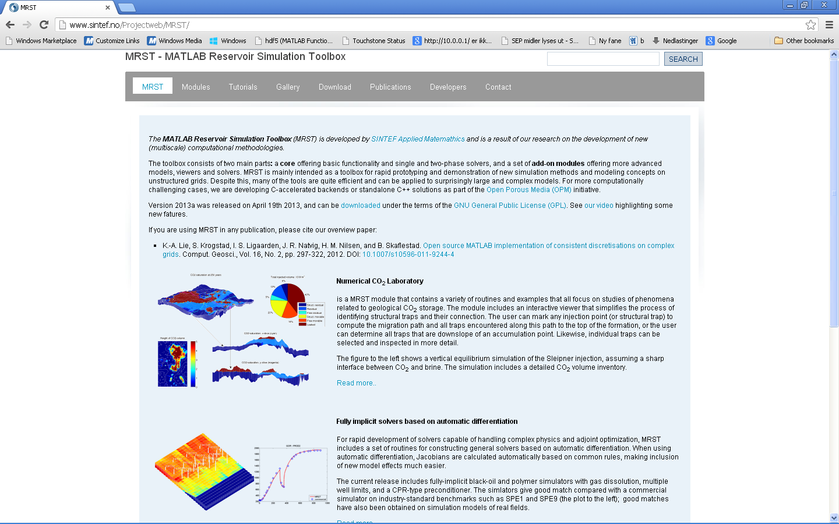
Matlab Reservoir Simulation Toolbox - MRST
An open source comprehensive set of routines for reading, visualising and running numerical simulations on reservoir models.
Developed at SINTEF Applied Mathematics.
MRST core: grid + basic functionality
Add-on modules: discretizations (TPFA, MPFA, mimetic), black oil, thermal, upscaling, coarsening, multiscale, flow diagnostics, CO2 laboratory,….
Statistics: (release 2013b)
Number of downloads: ~3000
Number of countries: ~120
Number og institutions: ~1080
http://www.sintef.no/MRST/
Main idea: flexibility and rapid prototyping
Light weight/
special purpose
Black box/
general purpose
complexity/ computational complexity

Slide 4
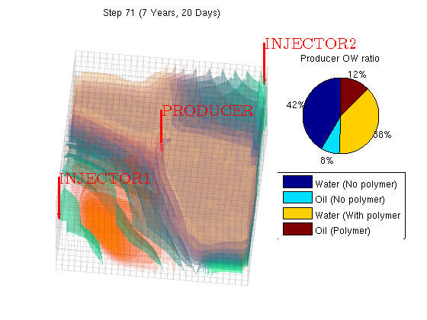
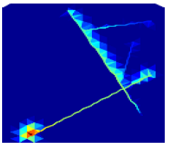
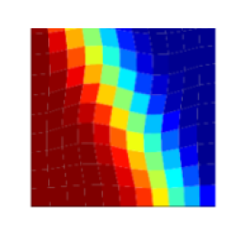
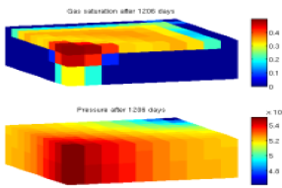
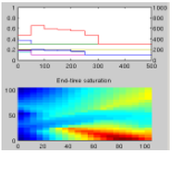
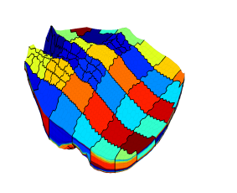
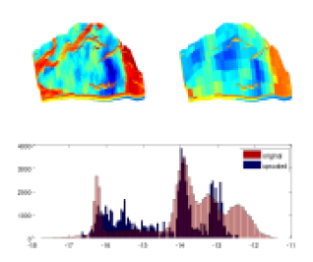
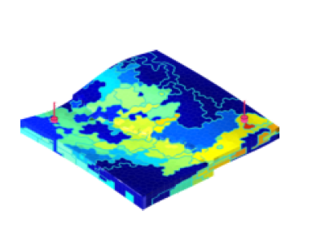
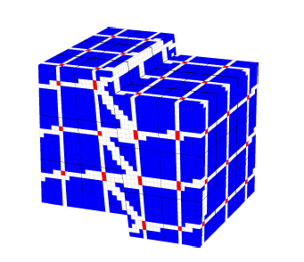
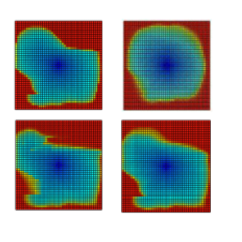
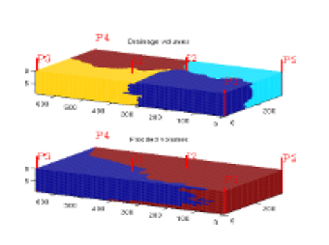
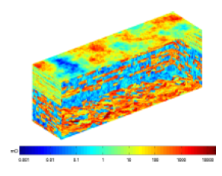
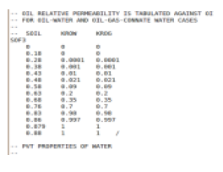
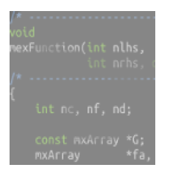
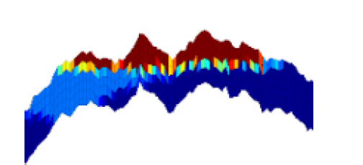
MRST add-on modules
Fully implicit solvers
(AD and gradients)
IMPES black-oil solvers
Discrete fracture models
Adjoint methods
MPFA methods
Multiscale mixed finite elements
Multiscale finite volumes
Single and two-phase upscaling
Grid coarsening
Ensamble Kalman filter
CO2 laboratory
Flow diagnostics
Data sets
(e.g. SPE 10)
Industry standard input formats
C-accelerated routines

Slide 5
Outline
Question:
Why is almost all simulations of reservoirs today using a fully implicit Two Point Method with Mobility upwinding.
Reservoir simulation: model , challenges
Fully implicit two point method's
  Problems, (Advantages)
Why not (?)
  Higher order
  Explicit saturation
  Operator splitting based
  MPFA, MIMETIC …
Conclusion/Challenges

Slide 6


Model: Black-oil model
3 component – 3phase model
components
 | W | O | G
W | X
O |  | X | X
G |  | X | X
phases
Surface (reference) conditions
Unknowns
Phase pressures
Phase saturations
Gas comp. in oil phase
Oil comp. in gas phase
Reservoir conditions

Slide 7
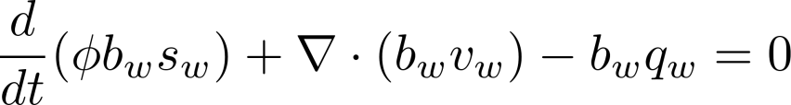
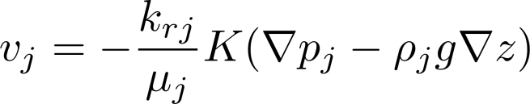
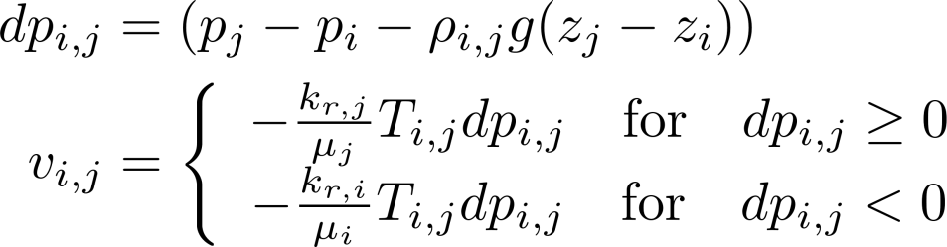
Black-oil model
Primary variables:
  Oil pressure
  Water saturation , gas saturation(/dissolved gas/dissolved oil)
Two point flux mobility upwinding:

Slide 8
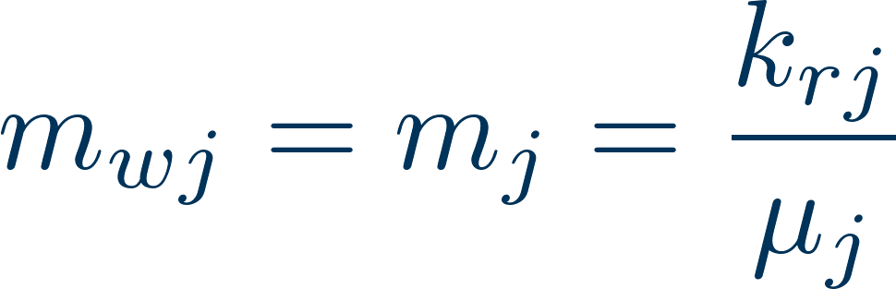

Black-oil model: wells
For each connection:
Well head computed explicitly based on phase distribution along well
For producing connection:
For injecting connection:
is the volume fraction of phase j in the injected mixture at connection conditions
Handling of cross-flow (implicit):
Compute inflow from producing connections (at reference conditions)
Compute average wellbore mixture (at reference conditions)
Compute average volumetric mixture at injection connection conditions
Compute injection connection mobilities

Slide 9
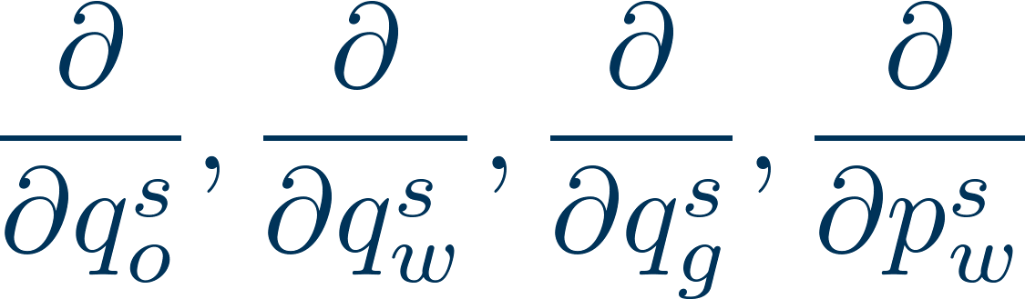



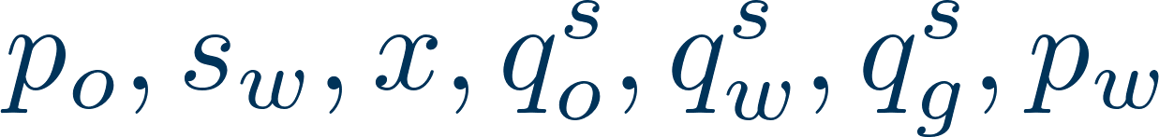
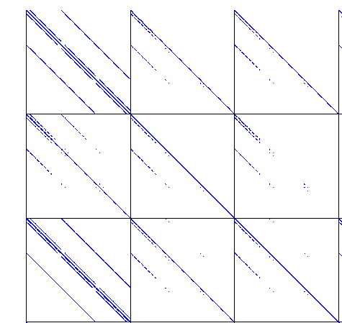

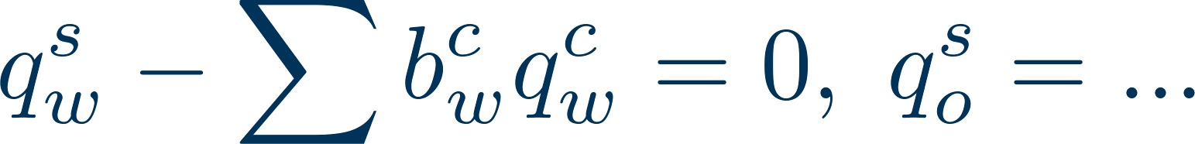
Black-oil model: Jacobian
Setting up the Jacobian:
Primary variables:
Equations:
  1-3 : reservoir equations
  4-6 :
  7 : well control (phase rates, bhp, …)
1
2
4567
3
dpW = s.grad(p-pcOW) - g*(rhoWf.*s.grad(z));upc = (double(dpW)>=0);
bWvW = s.faceUpstr(upc, bW.*mobW).*s.T.*dpW;
eqs{2} = (pv/dt).*( pvMult.*bW.*sW - pvMult0.*f.bW(p0).*sW0 ) + s.div(bWvW);

Slide 10
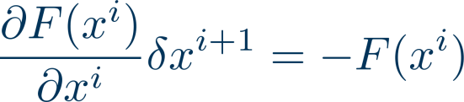
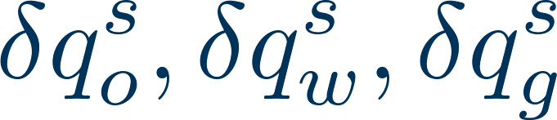

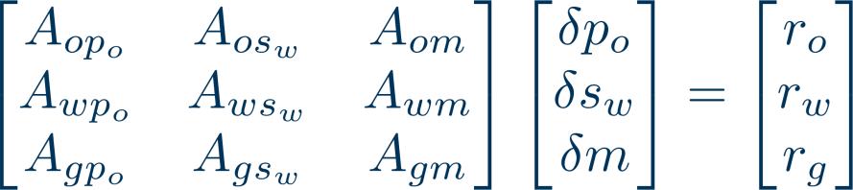
Black-oil model: linear system
Solution procedure for linear equation
Eliminate
Eliminate
After approximate decoupling of pressure, we solve the resulting linear system using GMRES with CPR precontitioner,
Recover remaining variables
Similar (transposed) approach implemented for adjoint equations
Appleyard chop performed when updating saturations
The CPR preconditioner consist of
  ILU on whole system
  Algebraic mulitgrid on pressure sub-system ,

Slide 11
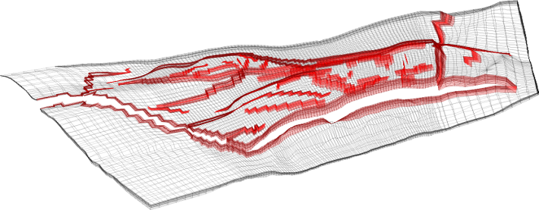
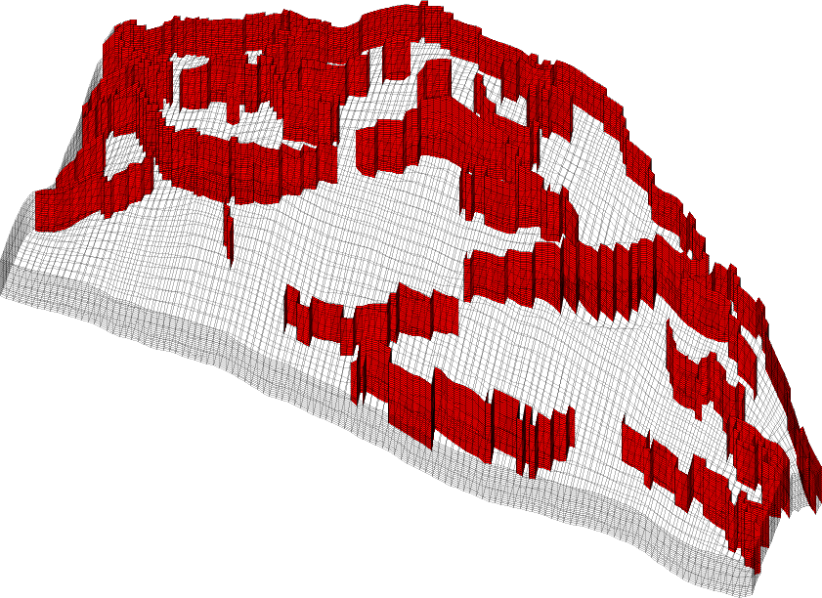
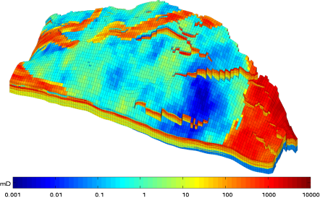
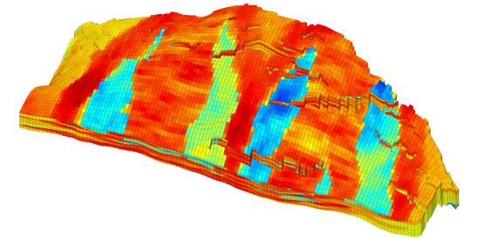
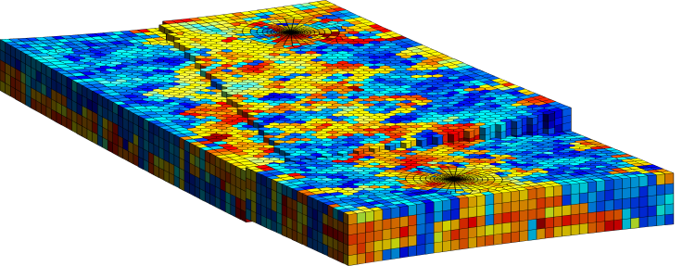
Grid: model and data
The structure of the reservoir ( geological , surfaces, faults, etc)
The stratigraphy of the reservoir (sedimentary structure)
Petrophysical parameters (permeability, porosity, net-to-gross, ….)

Slide 12
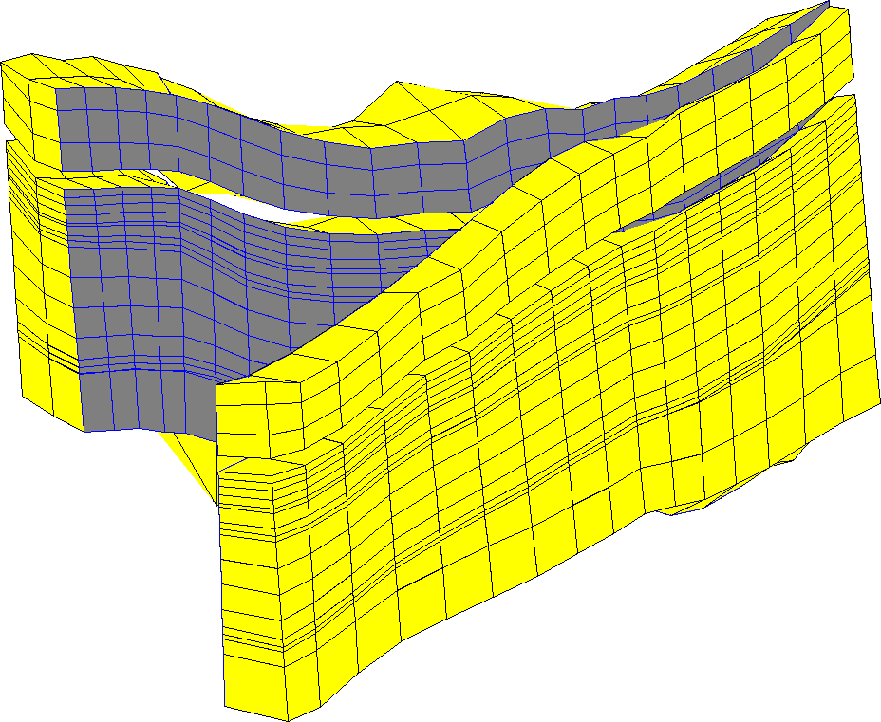
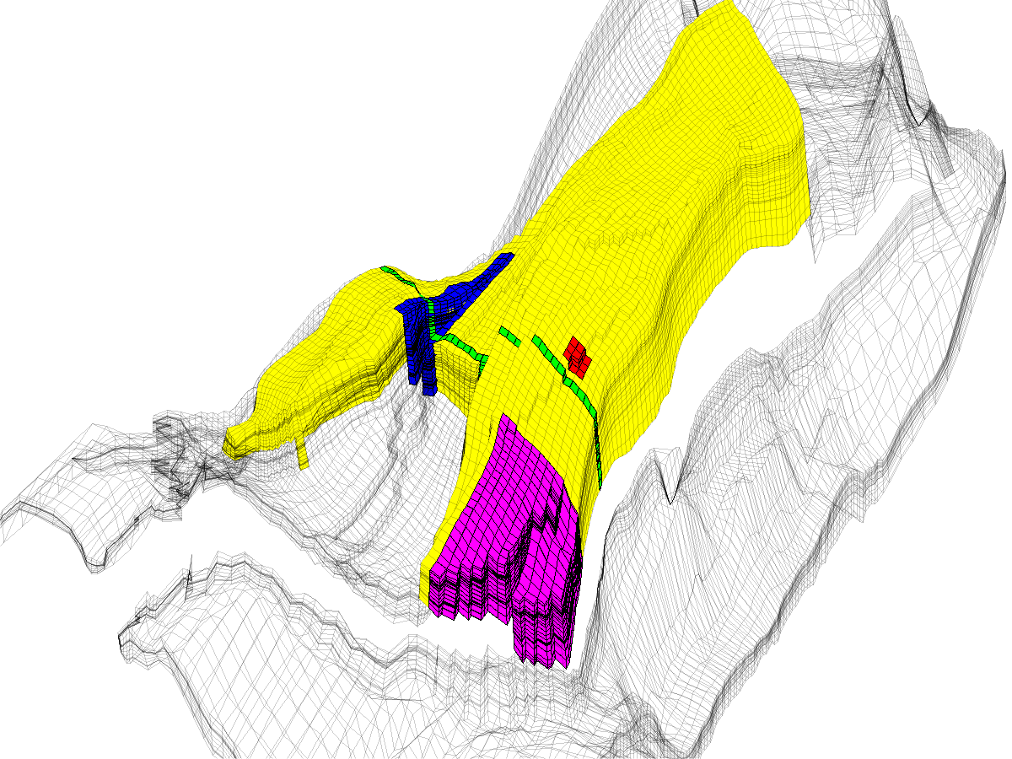
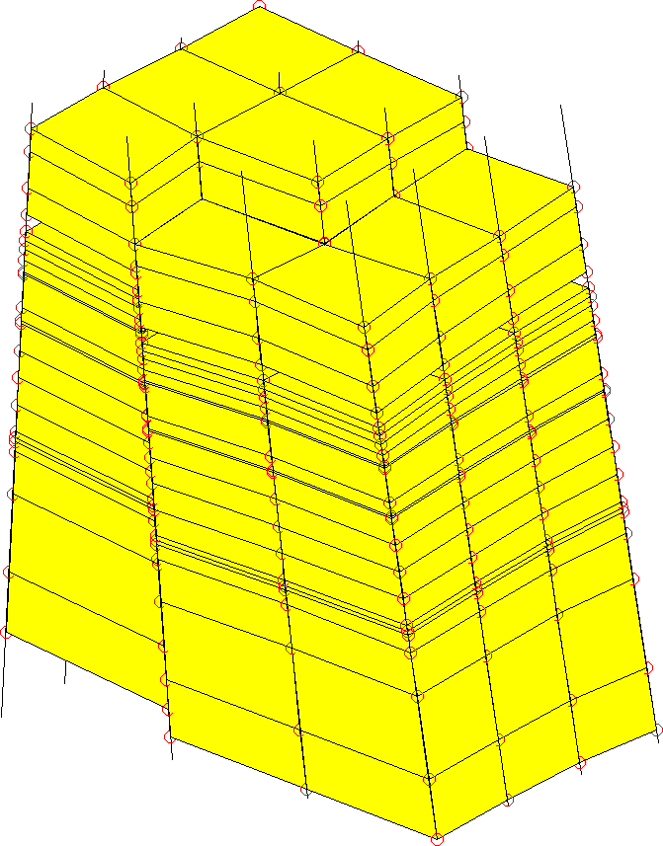
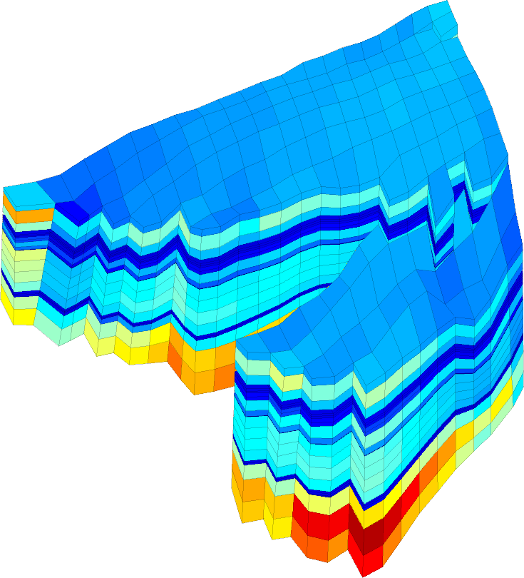
Grid: North Sea Model

Slide 13
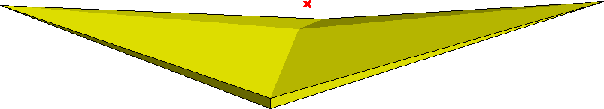
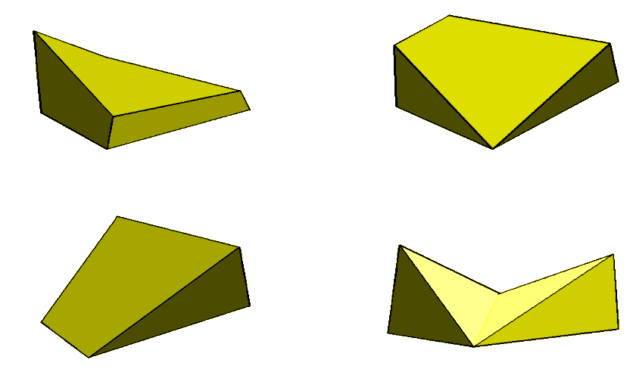
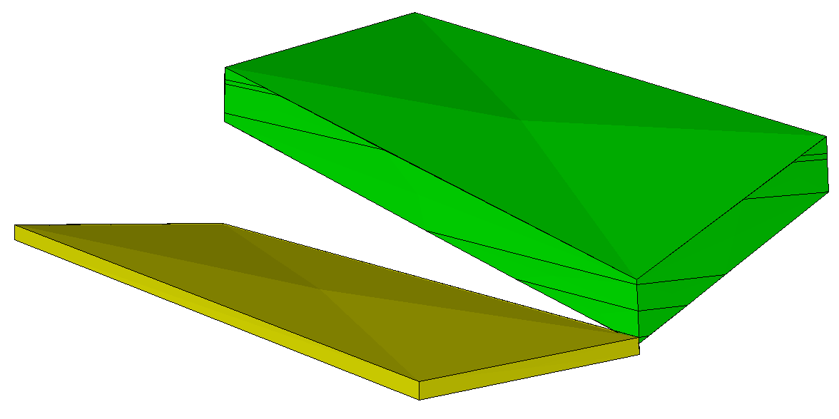
Grid: strange cells

Slide 14
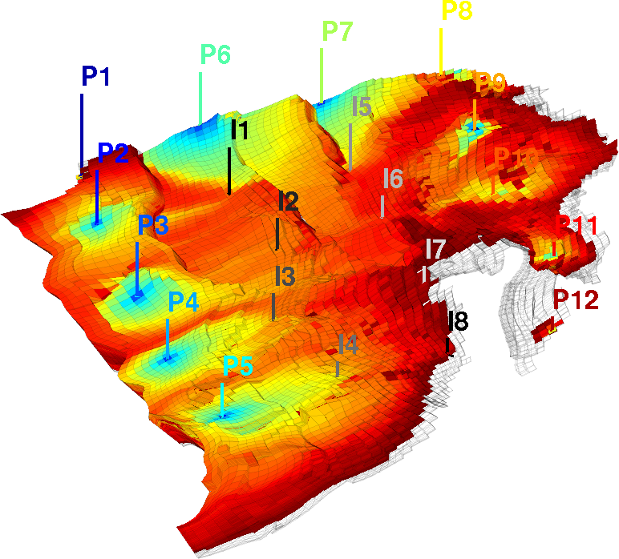
Few observations, few data
Wells are the observables
Observables:
  Well rates (oil, water, gas)
  Bottom hole pressure
Parameter knowledge
  Horizons – seismic
  Permeability , porosity, relative permeability from cores
  'Geological interpretation/knowleadge, interpolation, geostatistic
  historymatching
The incompressible single phase case have only n-1 degrees of freedom for all possible boundary conditions

Slide 15
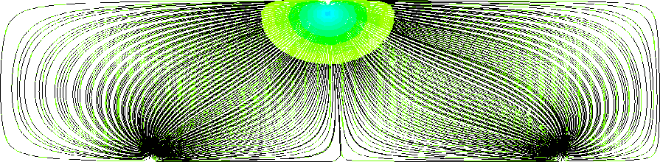
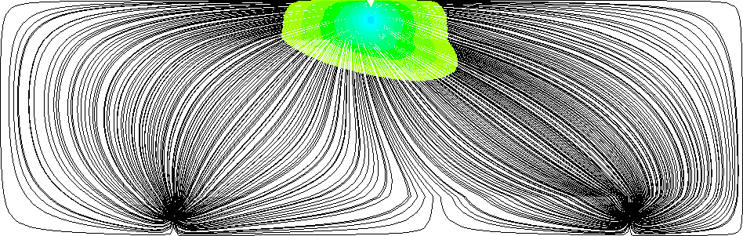
Grid orientation effects/ tensor permeability
Standard method + skew grid = grid-orientation effects
MPFA/mimetic : Consistent discretization methods capable of handling general polyhedral grids
Example:
Homogenous and isotropic medium with a symmetric well pattern
Water cut TPFA
Water cut, mimetic
Streamlines Mimetic
Streamlines TPFA
Upscaled models do have tensor permeability and relative permeability

Slide 16
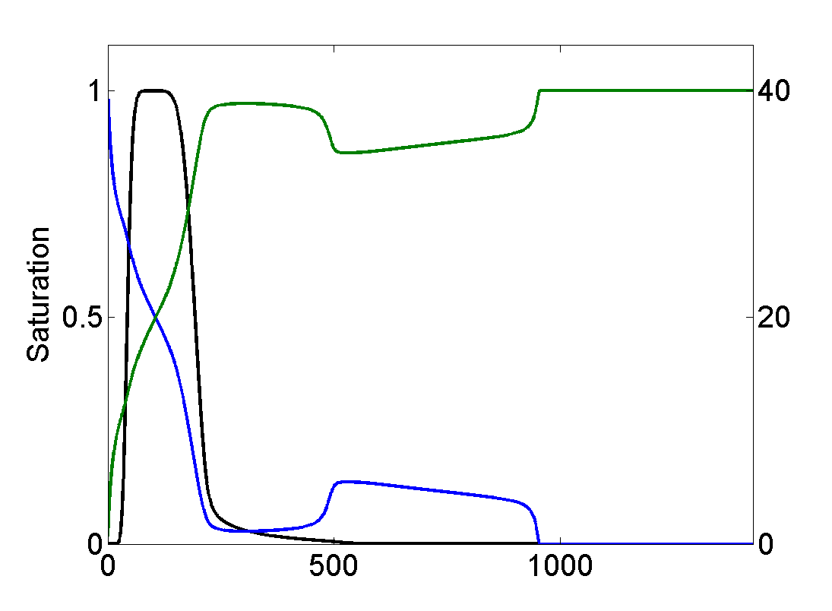


Numerical diffusion
Front capturing
Viscous fingering instabilities
Upwind need fine grid and small time steps to resolve a polymer slug
Viscous fingering comparing a fully implicit single-point upwind and 'TVD-type' schemes

Slide 17

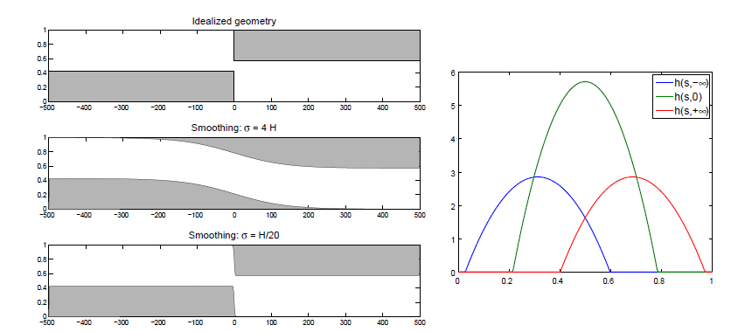
Discontinuous Riemann problem
Upwind method do not always give the physical solution

Slide 18
Proposed methods:
Explicit
Splitting:
  Full system
    Pressure and transport
  Transport:
    Advection, (convection) diffusion
High order:
MPFA, MIMETIC, Mixed finite element, DG
Parallelization:

Slide 19
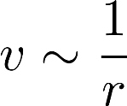
Explicit methods
Heterogeneity (grids):
  small cells
  high porosity
Wells
  Velocity
High CFL numbers from localized features

Slide 20
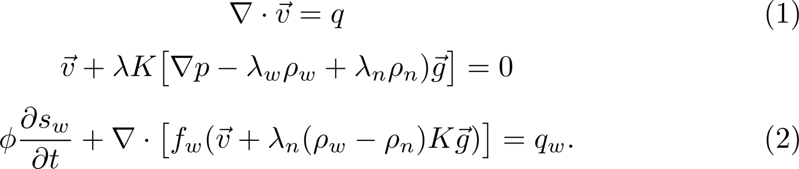

Splitting:
Pressure ("elliptic") – transport ("hyperbolic")
Incompressible two phase flow:
Equation 1) independent of saturation (and pressure)
Equation 2) has solution if

Slide 21
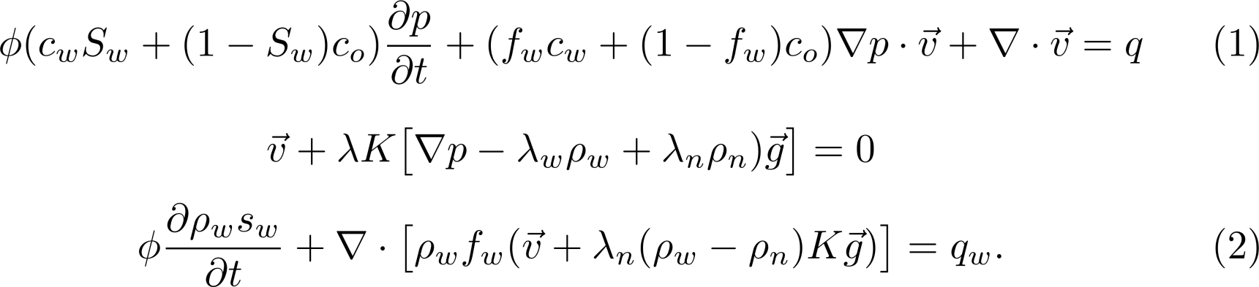
Splitting:
Pressure ("elliptic") – transport splitting ("hyperbolic")
Equation 1) not independent of saturation
There may be no solution to 2) if 1) is not fulfilled
  Saturation outside range (0,1)

Slide 22
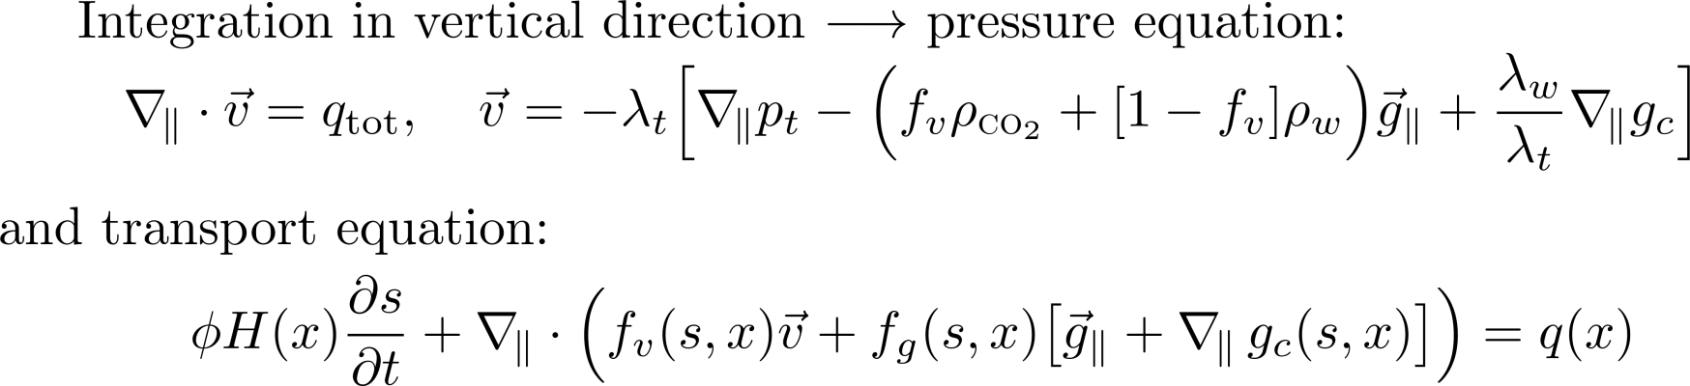
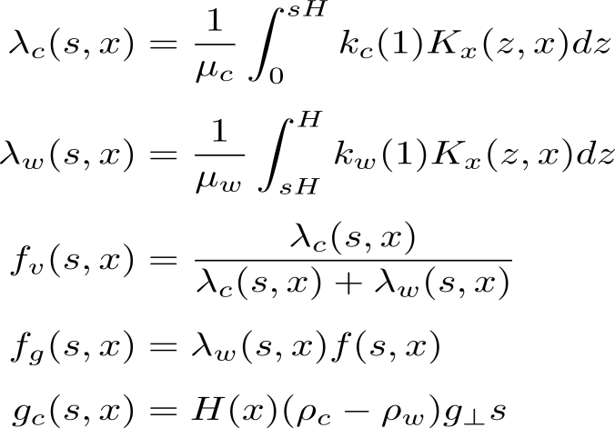
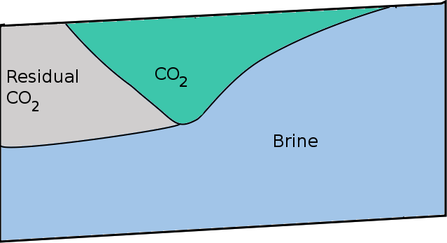

Strong coupling: Vertical equilibrium model
The "transport" equation have obtained a parabolic term, by strong gravity coupling to pressure equation.

Slide 23


Entry pressure: illustration
completely given by boundary conditions

Slide 24
High order
Pressure
  Heterogeneity permeability
  Large uncertainty
  No gain?
Transport ( DG?)
  Splitting to transport problem?
  Explicit methods excluded, need to be implicit

Slide 25

MIMETIC, MPFA, ..
Pressure equation
  Problematic for aspect ratio: anisotropy (MPFA/mimetic(?))
  More expensive : (Mimic 3 times dof, 2 times bandwidth)
  Limited experience: Nonlinear methods
Coupled system
  Formulation ? (Mixed, mimetic,…)
  Stability for hyperbolic part: Upwinding ?, numerical flux ?
  Physical effects
    Gravity, Capillary pressure, wells and dissolution

Slide 26
Others
Parallelization
  Communication costs due to need for implicit solver
  Difficulty of partitioning due to
    Channelized flow
    Long horizontal Wells, give nonlocal connections
Methods using simplexes
  Aspect ration imply to many grids

Slide 27
Our view on specific challenges for reservoir simulation
Large aspect ratio
  Reservoirs: 10 km laterally , 50-200 m vertically
Discontinuities:
  Permeability
  Relative permeability
  Capillary pressure
Grid and model parameter are strongly connected
  strange grids, general polyhedral cells
Coarse grid
  Grid cells typically 100m laterally , 4 m vertically
  Transport hyperbolic
Strong coupling between "elliptic" and "hyperbolic" variables
  Large scale: gravity
  Smaller scale: capillary pressure
Non local connections:
  Wells or fast flowing channels
  Parallelization

Slide 28
What is used from our work
In industry
  Upscaling using mimetic
  Ideas from multiscale
In research
  Matlab Reseroir Simulation Toolbox (MRST)
    Access to industry grids
    Simple unstructured grid
  Coarsening strategies
  Fast prototyping

Slide 29
Conclusion: What is needed
Research should focus on:
  Methods for general challenging grid with generic implementation
  Methods which work for elliptic, parabolic and hyperbolic problems
  Methods for strongly coupled problems
  Tensor Mobilities
Specific purpose simulators
  Codes using modern methods for correctly simplified systems
Accept for simplifications
  In reservoir simulation an fully implicit solve using TPFA and mobility upwinding is ofhen assumed to be the truth.
Work flows including:
  Simple models
  Numerical (specific) upscaled/reduced models
  Trusted simulations/"Full physics simulations."
Open source
  Simulators to challenge industry simulators
  Implementations of current research
Open Data
  Real reservoir models as benchmark

Slide 31







More advanced operator splitting

Slide 32

Vertical equilibrium calculations: inventory
Phase model:
  incompressible
  compressible
  dissolution
Relative permeability models
  sharp interface
  capillary fringe
  detailed hysteric model
  upscaling of subscale variations

Slide 33



Simulation of Sleipner Layer 9
Experience
Depth-integrated models are highly efficient and sufficiently accurate to predict long-term plume migration
Often more accurate than unresolved 3D simulations
Gravity dominated flow highly sensitive to small changes in top surface

Slide 34
Relperm upscaling:

Slide 35



Fully implicit code
Based on automatic differentiation for autoamtic generation of Jacobians
Gradients obtained through adjoint simulations
Current models
  Oil/water (+ polymer/surfactant)
  Oil/gas
  3-phase black oil (live oil/dry gas)
Benchmarked against commercial simulator on real field black oil model
~20 years of historic data
Virtually identical results
Commercial
MRST

Slide 36




Numerical Example (Black oil)
SPE9 – 3 phase black-oil
1 water injector, rate-controlled – switches to bhp
25 producers, oil-rate controlled – most switch to bhp
Appearance of free gas due to pressure drop
Almost perfect match between MRST and commercial simulator
Oil rates at producers 1, 3 and 4

Slide 37






Numerical Example (Black oil)
GOR at a producer 1, 3 and 4
BHP at producers 1, 3 and 4

Slide 38

Background: time-of-flight (TOF) and tracer equations
In this context: TOF and stationary tracer equations are solved efficiently after a single flow (pressure) solve:
TOF: the times it takes for a particle to travel from
injector to a given location
a given location to a producer
Stationary tracer: portion of volume that eventually will
arrive at a given producer
come from a given injector

Slide 39




Diagnostics based on time-of-flight (TOF) and tracers
Efficient ranking of geomodels
Reduce ensamble prior to (upscaling and) full simulation
Need measures that correlate well with e.g., receovery prediction
Validation of upscaling
Use allocation factors for assessing quality of upscaling
Visualization
See flow-paths, regions of influence, interaction regions etc
Immediately see effect of new well-placements, model updates etc.
Optimization
Use as proxies in optimization to find good initial guesses.
Need measures that correlate well to objective (e.g, NPV)

Slide 40
MRST add-on modules
Fully implicit solvers
(AD and gradients)
IMPES black-oil solvers
Discrete fracture models
Adjoint methods
MPFA methods
Multiscale mixed finite elements
Multiscale finite volumes
Single and two-phase upscaling
Grid coarsening
Ensamble Kalman filter
CO2 laboratory
Flow diagnostics
Data sets
(e.g. SPE 10)
Industry standard input formats
C-accelerated routines

Slide 41
Fit-for-purpose reservoir simulation
Flexible simulators that are easy to extend with new functionality and scale with the requirement for the accuracy and computational budget
accuracy +speed + robustness + access to gradients + model tuning
seconds
minutes
hours
Diagnostics/proxies
Upscaling
Fully implicit
Physics.-based proxies
Not accurate but qualitatively correct
Optimization: fast response enables extensive search
Characterization: ranking of model ensembles
Traditional upscaling
Mulitscale methods
Model-reduction techniques
Training runs to calibrate upscaling/model reduction
Case-based upscaling enables more aggressive coarsening
Automatic differentiation: rapid development of new time-consuming but robust fully-implicit simulators
Fast simulation methods (educated simplifications)
Sensitivities: adjoint

Slide 42


Black-oil model
Water equation discretized in time:
Matlab code:
eqs{2} = (pv/dt).*( pvMult.*bW.*sW - pvMult0.*f.bW(p0).*sW0 ) + s.div(bWvW);
eqs{2}(wc) = eqs{2}(wc) - bWqW;

