Slide 1
Higher form gauge fields and membranes in D=4 supergravity
Dmitri Sorokin
INFN, Padova Section, Italy
Based on arXiv: 1706.09422, 1803.01405
with I. Bandos, F. Farakos, S. Lanza & L. Martucci
“Higher Structure in M-theory, Durham, August 14, 2018

Slide 2
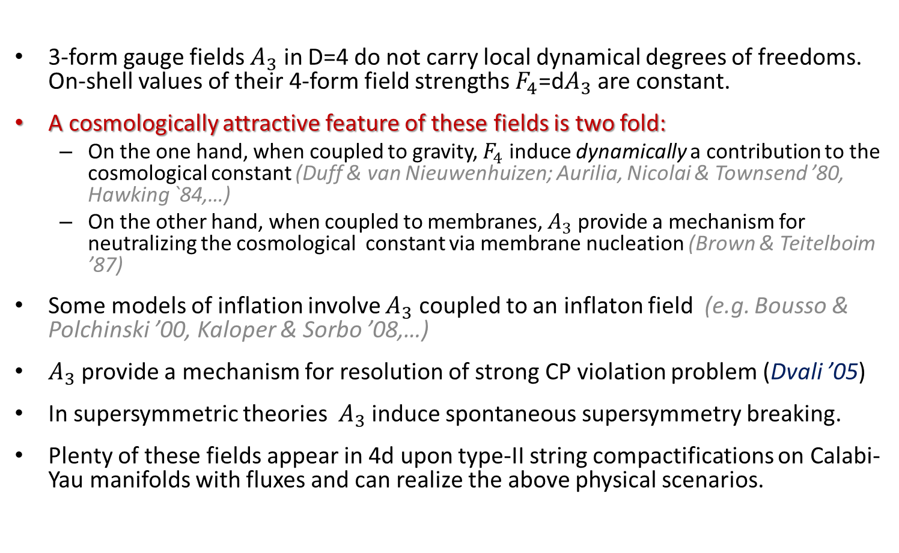
Introduction and motivation
3-form gauge fields $A_{3}$ in D=4 do not carry local dynamical degrees of freedoms. On-shell values of their 4-form field strengths $F_{4}$=d$A_{3}$ are constant.
A cosmologically attractive feature of these fields is two fold:
  On the one hand, when coupled to gravity, $F_{4}$ induce dynamically a contribution to the cosmological constant (Duff & van Nieuwenhuizen; Aurilia, Nicolai & Townsend ’80, Hawking `84,…)
  On the other hand, when coupled to membranes, $A_{3}$ provide a mechanism for neutralizing the cosmological constant via membrane nucleation (Brown & Teitelboim ’87)
Some models of inflation involve $A_{3}$ coupled to an inflaton field (e.g. Bousso & Polchinski ’00, Kaloper & Sorbo ’08,…)
$A_{3}$ provide a mechanism for resolution of strong CP violation problem (Dvali ’05)
In supersymmetric theories $A_{3}$ induce spontaneous supersymmetry breaking.
Plenty of these fields appear in 4d upon type-II string compactifications on Calabi-Yau manifolds with fluxes and can realize the above physical scenarios.
Notes:
In this talk I would like to review how these fields dynamically generate a cosmological constant term in Einstein equations and a mechanism which makes the value of this cosmological constant tiny. I will also discuss the strucutre of 4d supergravity theories that contain these three-form gauge fields and membranes and that effectively describe string compactifications with RR fulxes.

Slide 3
Three-form gauge fields in 4D space-time
Rank-3 antisymmetric gauge fields:
Guage-invariant field strength:
Three-form field Lagrangian coupled to gravity
boundary term
Notes:
The boundary term ensures the consistency of the variation principle requring \delta F=0 on the boundary.

Slide 4
Equations of motion and cosmological constant generation
Hence
The cosmological constant has been generated dynamically
by a classical constant value E of the gauge field strength

Slide 5
Membrane nucleation and diminishing of the cosmological constant (Brown & Teitelboim ’87)
3-form gauge field minimally couples to 2d domain walls (membranes)
membrane mass
(tension)
membrane charge
parametrizes membrane worldvolume
3-form field equation:
- membrane current

Slide 6
Membrane nucleation and neutrilization of the cosmological constant (Brown & Teitelboim ’87)
Membrane creation probability
Process stops at
Notes:
The difficulty here is that membrane bubbles may not be produced fast enough, or expand rapidly enough to completely convert the rapidly expanding universe to one of lower cosmological constant. In fact, it turns out that the rate for membrane production is decreased by letting either its mass m be large or |e| be small, at least for most membrane creation processes which reduce Lambda. Then the condition that membrane creation stops when Lambda is small also forces the creation rate to be small.

Slide 7
Issues and rectification of the mechanism
In this simple scenario, to reach the experimentally observed value of the cosmological constant the membranes should be heavy (large m) and weakly coupled (small q)
with this characteristics the membranes are nucleated too slowly and time of transition from an initial (Plank) value of the cosmological constant to its present value is much greater than the age of the Universe.
Improvments (Bousso & Polchinski, ‘00 and others)
  multiple 3-form gauge fields are required
  their coupling to the inflaton and membrane nucleation produce regions in the Universe with different cosmological constants. We leave in a region in which its value is small.
Recent inflationary models intensively exploit these ideas.
Notes:
Lambda = 10^{-52}m^{-2} or 10^{-122} reduced Plank units.

Slide 8
Effective field theories of type II string and M-theory compactifications with fluxes
Gukov, Vafa, Witten; Taylor, Vafa ’99; Luis & Miku ’02; Blumenhagen et.al. ’03, Grimm, Luis ’04 …
…Bielleman, Ibanez & Valenzuela ’15,…
D=10 Type IIA bosonic field content
NS-NS sector:
RR sector:

Slide 9

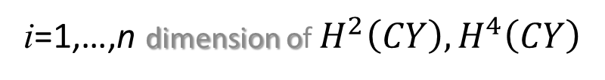

Effective N=1, D=4 theories of type IIA string compactifications with RR fluxes (Bielleman et.al ’15)
Compactification on $M_{4}$ ×${ CY}_{3}$ and $F_{4}$ fluxes on $M_{4}$,
dots stand for contributions of $B_{2}$
CY volume form
i=1,…,n dimension of $H^{2}\left(CY\right), H^{4}\left(CY\right)$
basis of closed forms
2n+2 internal quantized constant fluxes
2n+2 ${ F}_{4}$field strengths on $M_{4}$
Relevant 4D scalar fields:
4D on-shell relations:
Notes:
Usually, people study the dimensional reduction of such compactifications by keeping independent the internal fluxes, i.e. those which wrap CY cycles. In such a setup their dual four-form fluxes do not appear in the effective 4D theory. Instead, our goal is to keep the four-form fluxes as independent fields and to construct a dual effective 4D theory describing this type of string compactifications.
Note that the number of Fi4 and tilde Fi4 is the same as the real number of phi. This was a reason to consider these fields as part of chiral supermultiplets, while the remaining F04 and tilde F04 are assumed to be related to the complex scalar auxiliary fields of old minimal supergravity.

Slide 10
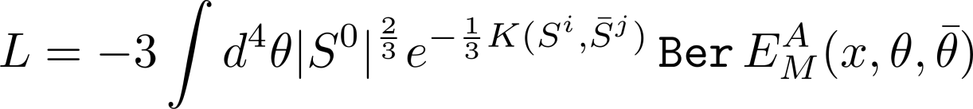
Effective N=1, D=4 SUGRA Lagrangian
(F. Farakos, S. Lanza, L. Martucci, D.S. ‘17)
The scalar moduli, the 4-form fluxes and their fermionic superpartners
form special chiral superfields
4d Hodge-duals of 4-form fluxes
prepotential of special Kaehler
space of scalar moduli
complex linear superfields
No superpotential
Conformal compensator
supervielbein of N=1, D=4 sugra

Slide 11

Dual (conventional) description in terms of usual chiral superfields
independent auxiliary fields
It is obtained by solving the equations of motion of the
3-form potentials in the higher-form formulation
Notes:
But one needs to deal with the formulation with the 3-form gauge fields to introduce membranes.

Slide 12
Duality between chiral and 3-form supermultiplets
Chiral N=1 superfield:
Polonyi ‘77 Lagrangian:
On shell:
We would like to generate the parameter c dynamically by dualizing f into F
Double 3-form supermultiplet (Gates ‘81) :
Special chiral superfield: in which
where
is a complex linear superfield

Slide 13
Systematic manifestly-susy dualization procedure
Replace the Lagrangian
with
Equations of motion:
Dual Lagrangian:
Note that the dual Lagrangian does not contain the superpotential
and the constant parameter

Slide 14

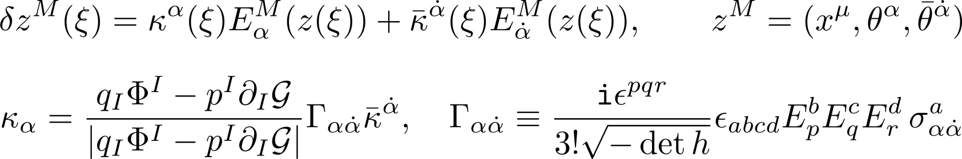
Coupling to supermembranes
(I. Bandos, F. Farakos, S. Lanza, L. Martucci, D.S. ‘18)
Generalization of previous results of Ovrut & Waldram ’97, Huebscher, Meessen & T. Ortin ’09,
Bandos & Meliveo ‘10-’12, Buchbinder, Hutomo, Kuzenko & Tartaglino-Mazzucchelli ‘17
Kappa-symmetry invariant action
- membrane worldvolume coordinates
Kappa-symmetry variations:
The action can be used for studying e.g. BPS domain walls associated with membranes separating different susy vacua, as well as the Brown-Teitelboim mechanism
Notes:
Membranes appear in 4d as remnants of D-branes wrapping non-trivial CY cycles.

Slide 15



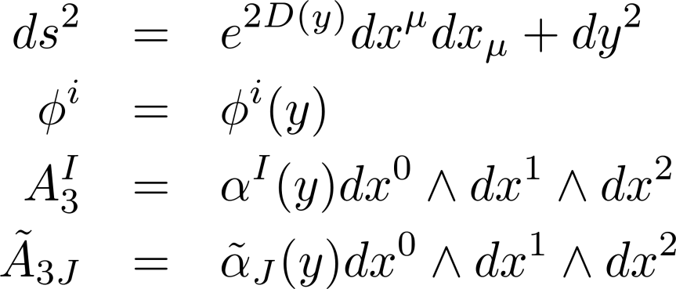
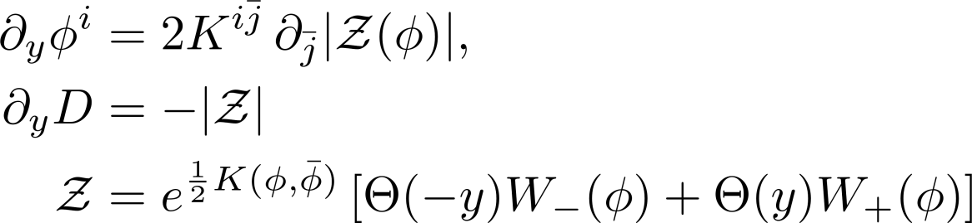
½-BPS domain walls
(Cvetic et. al. ’92-’96, Ovrut & Waldram ’97, Ceresole et. al. ’06,
Huebscher, Meessen & Ortin ’09 ….)
membrane
y
Flat static domain wall ansatz:
Flow equations
(consequences of susy preservation)
functions are continuous but not smooth

Slide 16

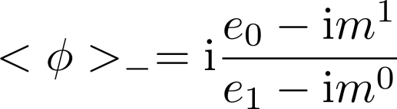
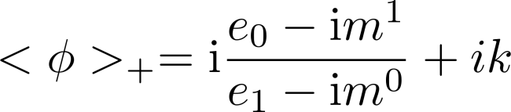
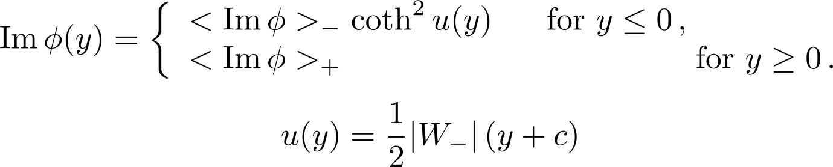
Simple example of an analytic solution generated by four 4-form fluxes
Brane charges
Susy AdS vacua
Interpolating domain wall solution of the flow equations:

Slide 17

Profiles of the domain wall

Slide 18
Conclusiion
Three-form gauge fields in D=4 have interesting physical implications:
  Generation of a cosmological constant and its diminishing via nucleation of membrane bubbles
  non-zero vevs of four-form fluxes trigger spontaneous symmetry breaking
String Theory compactifications provide plenty of such fields in effective matter-coupled D=4 supergravities where they play the role of auxiliary fields of special chiral supermultiplets
We have constructed manifestly supersymmetric action describing the effective N=1 4d theory of type IIA string compactifications with RR fluxes, coupled it to a kappa-symmetric supermembrane and find new analytic ½-BPS domain wall solutions in this system.

Slide 19
Outlook
To extend this 3-form supergravity construction to phenomenologically more relevant compactification setups in type IIA and IIB theories which include
  the NS-NS fluxes
  D-branes (which are required for introducing a gauge field sector)
To further study phenomenological and cosmological implications of these models within the lines of Bousso & Polchinski ’00, Kaloper & Sorbo ’08,…, Bielleman, Ibanez & Valenzuela ’15, Carta, Marchesano, Staessens & Zoccarato ’16,…

