Slide 1
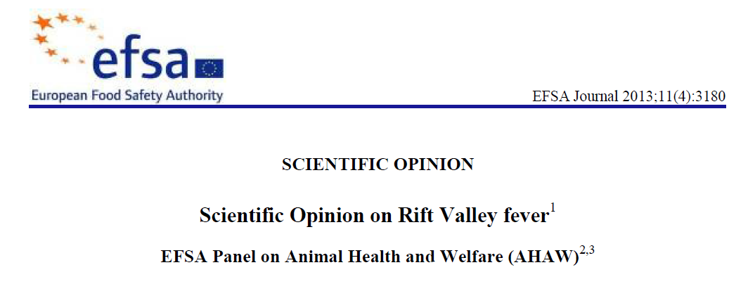
Example from EFSA work

Slide 2
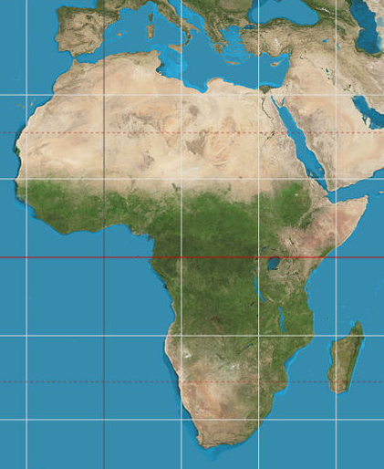
Rift Valley Fever
Affects cattle, sheep, goats and camels
Virus transmitted by mosquitoes
Endemic in East and West Africa
AHAW were asked to assess risk of entry into North Africa
Map by Strebe, via Wikimedia Commons

Slide 3
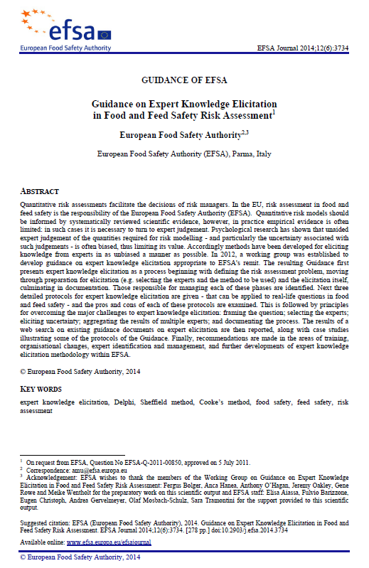
What is EKE?
Expert Knowledge Elicitation
‘A systematic, documented and reviewable process to retrieve expert judgements from a group of experts in the form of a probability distribution’
EFSA EKE Guidance 2014

Slide 4
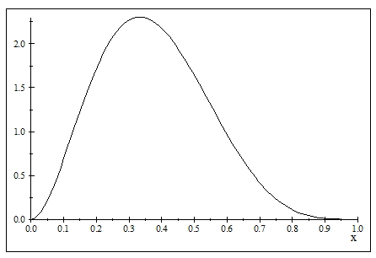
Sheffield EKE method
Probability density
Asks experts for:
  first, judgements for the plausible range
  then, judgements for the median and quartiles
…uses these to fit distributions for the experts to review
…finally, elicits a group distribution by discussion
L = 0, U = 1
M = 0.36
Q1 = 0.25
Q3 = 0.49
50%
50%
25%
25%
25%
25%
25%
25%
25%
25%
[
]
Parameter value

Slide 5
EKE Example: AHAW Rift Valley Fever assessment
Limited information for key parameters including:
  Number of animals exported from East and West Africa to North Africa in 2013
So AHAW used EKE to obtain expert judgements
Invited relevant experts from Africa and the EU
Reviewed the relevant evidence
Elicited a distribution for each parameter using the ‘Sheffield’ method from the EKE Guidance

Slide 6
Example: number of animals exported from West region
Evidence considered by the experts for this parameter:
Undocumented animal movements can be expected, especially around the Feast of the Sacrifice
Nomadic lifestyle facilitates movement by herding
Trucks can take larger numbers but travel on controlled roads
The border between Mali and Algeria was completely closed during 2013
Morocco has stringent controls, but import of camels could still occur by desert roads
Libya was previously estimated to import 130,000 ruminants in 2012
Political unrest could have an enormous influence

Slide 7
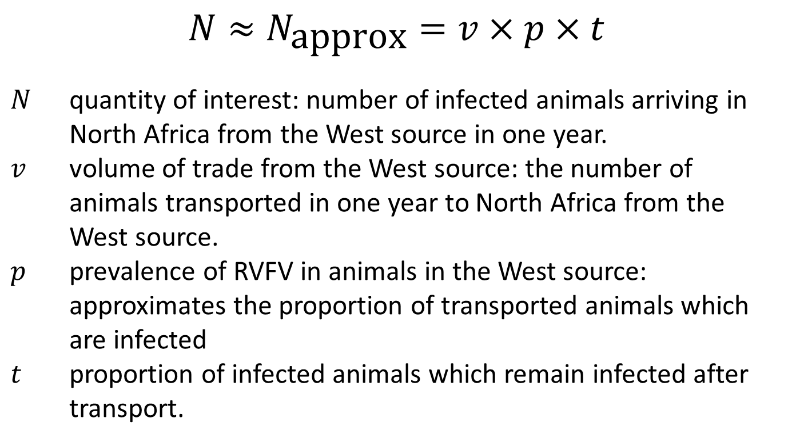
Example: Rift Valley Fever (EFSA, 2013)
Simplified version of assessment calculation (for West source)
$$N≈N_{\text{approx}}=v×p×t$$
$N$ quantity of interest: number of infected animals arriving in North Africa from the West source in one year.
$v$ volume of trade from the West source: the number of animals transported in one year to North Africa from the West source.
$p$ prevalence of RVFV in animals in the West source: approximates the proportion of transported animals which are infected
$t$ proportion of infected animals which remain infected after transport.

Slide 8
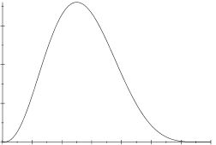
Example: number of animals exported from West region
‘The experts judged that it would be very unlikely that import from the west source into the RC would be below 25,000 and above 500,000 ruminants in 2013. The median was set at 260,000, with a high uncertainty.’
100,000
500,000
Number of animals
Essential to document the evidence and reasoning for every judgement

Slide 9
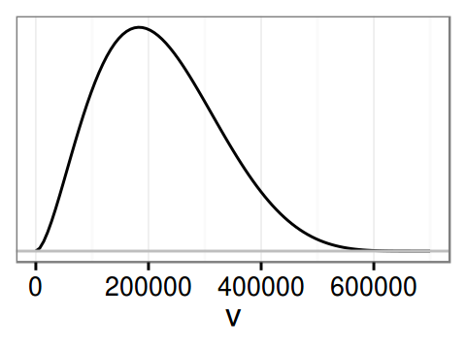
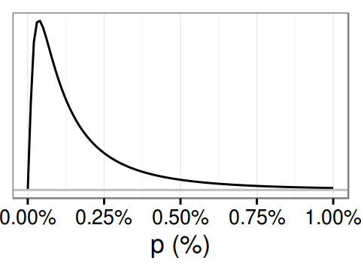
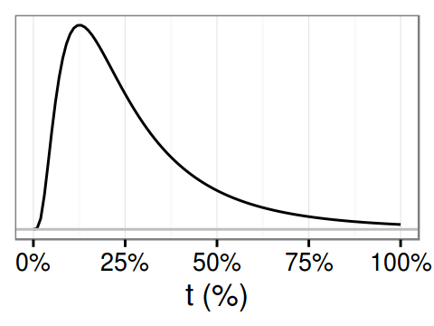
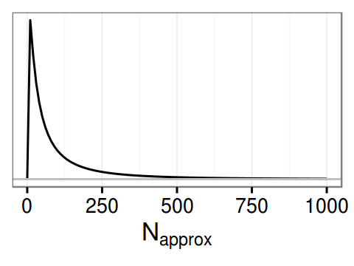
Rift Valley Fever: distributions for uncertainty
Volume of transport
Prevalence
EKE
EKE
Remaining infected
Number arriving infected
EKE
COMBINED UNCERTAINTY BY CALCULATION

Slide 10
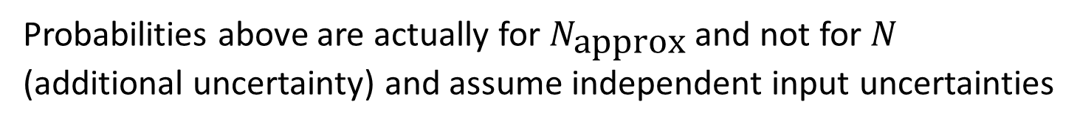
Rift Valley Fever: the result of the calculation
Number of infected animals arriving from West source?
Median estimate is 55
90% probability between 5 and 600
Probability more than 1000 is 2%
Benefit of the analysis: could not compute such probabilities without the elicited distributions for uncertainty about the inputs
Probabilities above are actually for $N_{\text{approx}}$ and not for $N$ (additional uncertainty) and assume independent input uncertainties

Slide 11
Uncertainty (U) or
Uncertainty about variability (U about V)?
Does the assessment calculation directly involve variable quantities?
Variability itself is close to omni-present in scientific assessments.
If variables appear:
  only indirectly in the assessment calculation, then we need only to address U
  directly in the assessment calculation, then we need to address U about V
What do directly and indirectly mean?
  indirectly for each variable, the calculation involves a specified percentile or other parameter representing variability.
  directly the calculation output is itself a variable.

Slide 12
Variability and uncertainty
Probability distributions can be used to represent just uncertainty, just variability, or uncertainty about variability
Distribution represents uncertainty about P
Distribution represents variability of V
True distribution for variability of W is unknown
Multiple distributions represent uncertainty about variability
P has a single true value which is uncertain
V has multiple true values
?
?
Parameter P
Variable V
Variable W
N.b. A parameter can be a real world constant
or a parameter describing variability (e.g. mean, variance, percentiles)
GD 5.2, Fig. 2

